Slide 1
Why should we give to others?

Slide 2
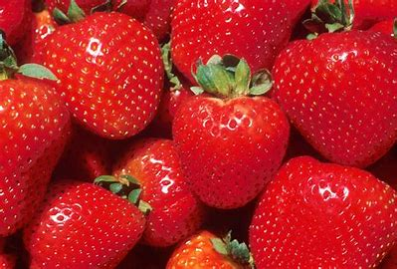
Why should we give to others?

Slide 3
Philippians 4
10 I rejoiced greatly in the Lord that at last you renewed your concern for me. Indeed, you were concerned, but you had no opportunity to show it. 11 I am not saying this because I am in need, for I have learned to be content whatever the circumstances. 12 I know what it is to be in need, and I know what it is to have plenty. I have learned the secret of being content in any and every situation, whether well fed or hungry, whether living in plenty or in want. 13 I can do all this through him who gives me strength.

Slide 4
Philippians 4
14 Yet it was good of you to share in my troubles. 15 Moreover, as you Philippians know, in the early days of your acquaintance with the gospel, when I set out from Macedonia, not one church shared with me in the matter of giving and receiving, except you only; 16 for even when I was in Thessalonica, you sent me aid more than once when I was in need. 17 Not that I desire your gifts; what I desire is that more be credited to your account.

Slide 5
Philippians 4
18 I have received full payment and have more than enough. I am amply supplied, now that I have received from Epaphroditus the gifts you sent. They are a fragrant offering, an acceptable sacrifice, pleasing to God. 19 And my God will meet all your needs according to the riches of his glory in Christ Jesus.
20 To our God and Father be glory for ever and ever. Amen.

Slide 6
Why should we give to others?
Need
Wellbeing
Pain or Gain?

Slide 7
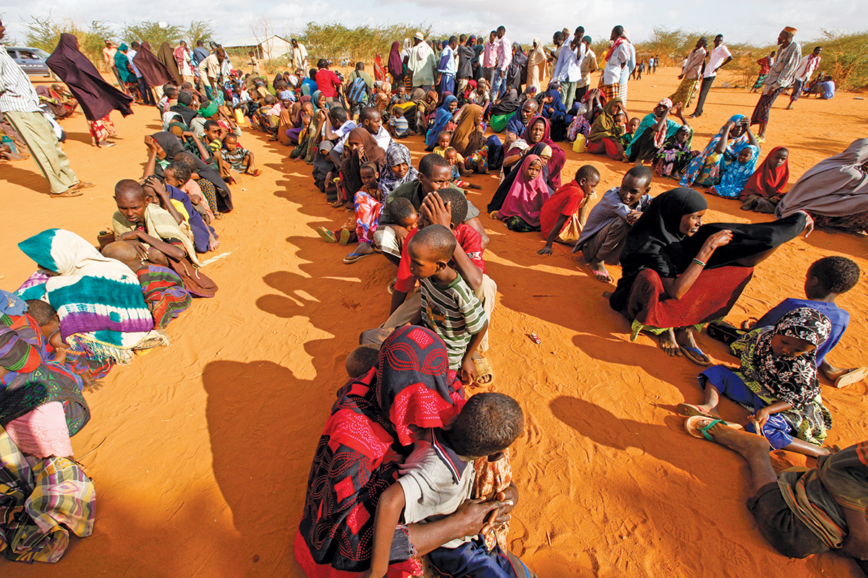
Why should we give to others?
Need

Slide 8
Why should we give to others?
Need
Jesus calls us to love God but also to love our neighbour as ourselves

Slide 9
Why should we give to others?
Need
Wellbeing

Slide 10
Why should we give to others?
Need
Wellbeing
Jesus said it is more blessed to give than receive.

Slide 11
Why should we give to others?
Need
Wellbeing
Jesus said it is more blessed to give than receive.
Giving builds community

Slide 12
Why should we give to others?
Need
Wellbeing

Slide 13
Why should we give to others?
Need
Wellbeing
Pain or Gain?

Slide 14
Pain or Gain? 2 Corinthians 8
And now, brothers and sisters, we want you to know about the grace that God has given the Macedonian churches. 2 In the midst of a very severe trial, their overflowing joy and their extreme poverty welled up in rich generosity. 3 For I testify that they gave as much as they were able, and even beyond their ability. Entirely on their own, 4 they urgently pleaded with us for the privilege of sharing in this service to the Lord’s people. 5 And they exceeded our expectations: they gave themselves first of all to the Lord, and then by the will of God also to us.

Slide 15
Pain or Gain?
Why are we giving?
How are we giving?

Slide 16
Pain or Gain?
Why are we giving?
How are we giving?
It is in the place of pain…that we can be transformed to be more like Jesus…and there is great gain in this life and the next of being more like Jesus.

Slide 17
Pain or Gain?
Also in our pain…of giving to others…Paul writes of reward in heaven.
17 Not that I desire your gifts; what I desire is that more be credited to your account...

Slide 18
Pain or Gain?
Also in our pain…of giving to others…Paul writes of reward in heaven.
17 Not that I desire your gifts; what I desire is that more be credited to your account...
19 And my God will meet all your needs according to the riches of his glory in Christ Jesus.

Slide 19
v13 I can do all this through him who gives me strength.
Chrissie Chapman’s book "The Night the Angels Came

Slide 20
Why give to others?
Chrissie Chapman’s book "The Night the Angels Came
“Madam missionary, I never realized that Jesus was all I needed, until Jesus was all I had.”

Slide 21
Is our God too small?
v13 I can do all this through him who gives me strength.
19 And my God will meet all your needs according to the riches of his glory in Christ Jesus
Philippians 3:13-14
But one thing I do: forgetting what is behind and straining towards what is ahead, 14 I press on towards the goal to win the prize for which God has called me heavenwards in Christ Jesus.

