Slide 1
The Journey…Perseverance

Slide 2
The Journey…Perseverance
Eugene Peterson
“discipleship is a long journey of obedience in the same direction.”

Slide 3
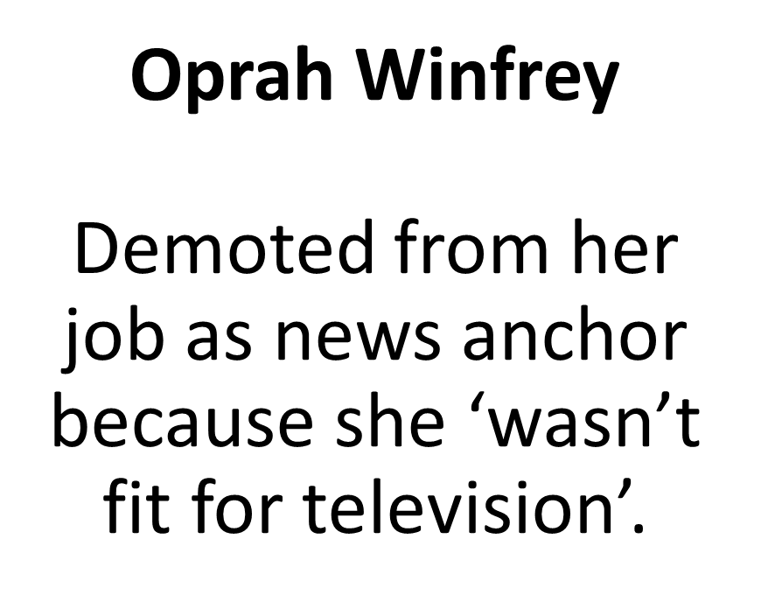
The Journey…Perseverance

Slide 4
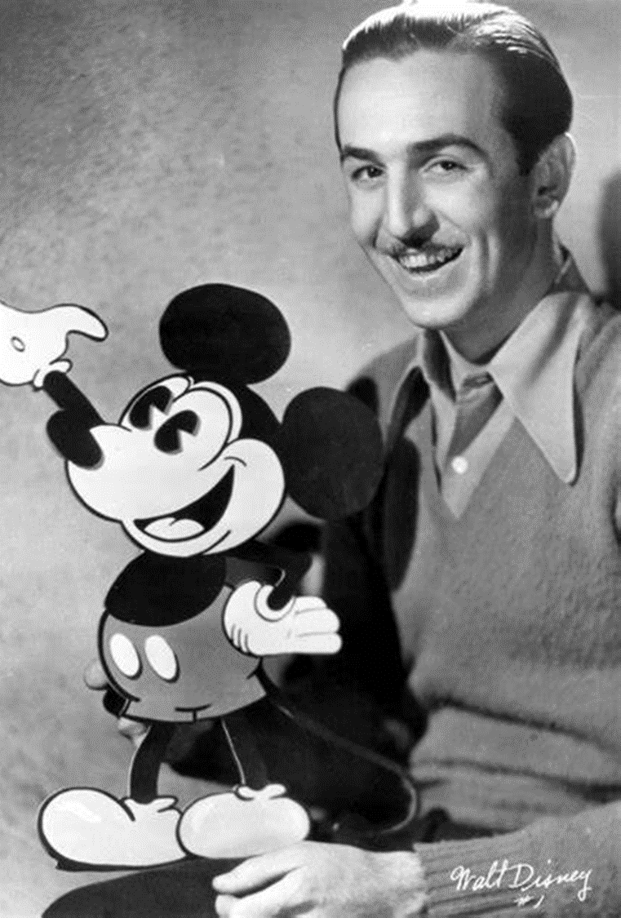
The Journey…Perseverance
Walt Disney Fired from a newspaper for ‘lacking imagination and having no original ideas.’

Slide 5
The Journey…Perseverance
Certain Hope
How to keep running
Fix your eyes on Jesus

Slide 6
Hebrews 12: Therefore, since we are surrounded by such a great cloud of witnesses, let us throw off everything that hinders and the sin that so easily entangles. And let us run with perseverance the race marked out for us, fixing our eyes on Jesus, the pioneer and perfecter of faith.

Slide 7
For the joy that was set before him he endured the cross, scorning its shame, and sat down at the right hand of the throne of God. Consider him who endured such opposition from sinners, so that you will not grow weary and lose heart.

Slide 8
Perseverance
Certain Hope
“Hope…an expectation of coming good based on the character and promises of God”. John Mark Comer

Slide 9
Perseverance
Certain Hope
Psalm 116
I love the Lord for he heard my voice
He heard my cry for mercy
Because he turned his ear to me
I will call on him as long as I live

Slide 10
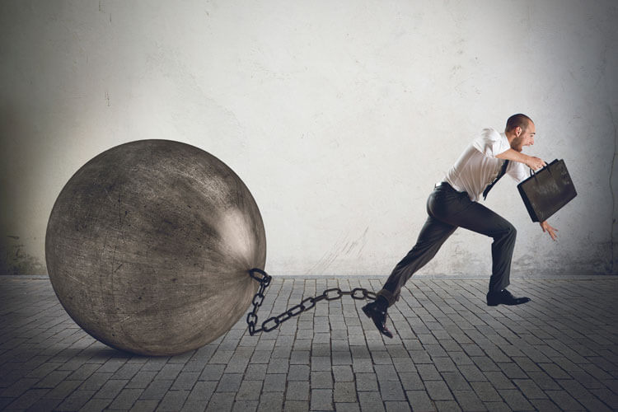
How to keep running…get rid of
Distraction
Sin
Forgiveness
Lack of direction

Slide 11
Fix our eyes on Jesus …It is Ok to stare (Bob Goff)
Wisdom
Example
Pioneer
Sufferer
Saviour
Lover
Faithful
Certain Hope
Victorious

Slide 12
The crown of thorns reminds us of the violence and pain of the cross and our world…Jesus knows our pain
The cross actually being there……speaks of God stepping into history…and saying you are loved and forgiven…you matter
The horizontal beam …are arms of welcome…to do life with God
The empty cross reminds us of certain hope and God going to put all things right

