Slide 1
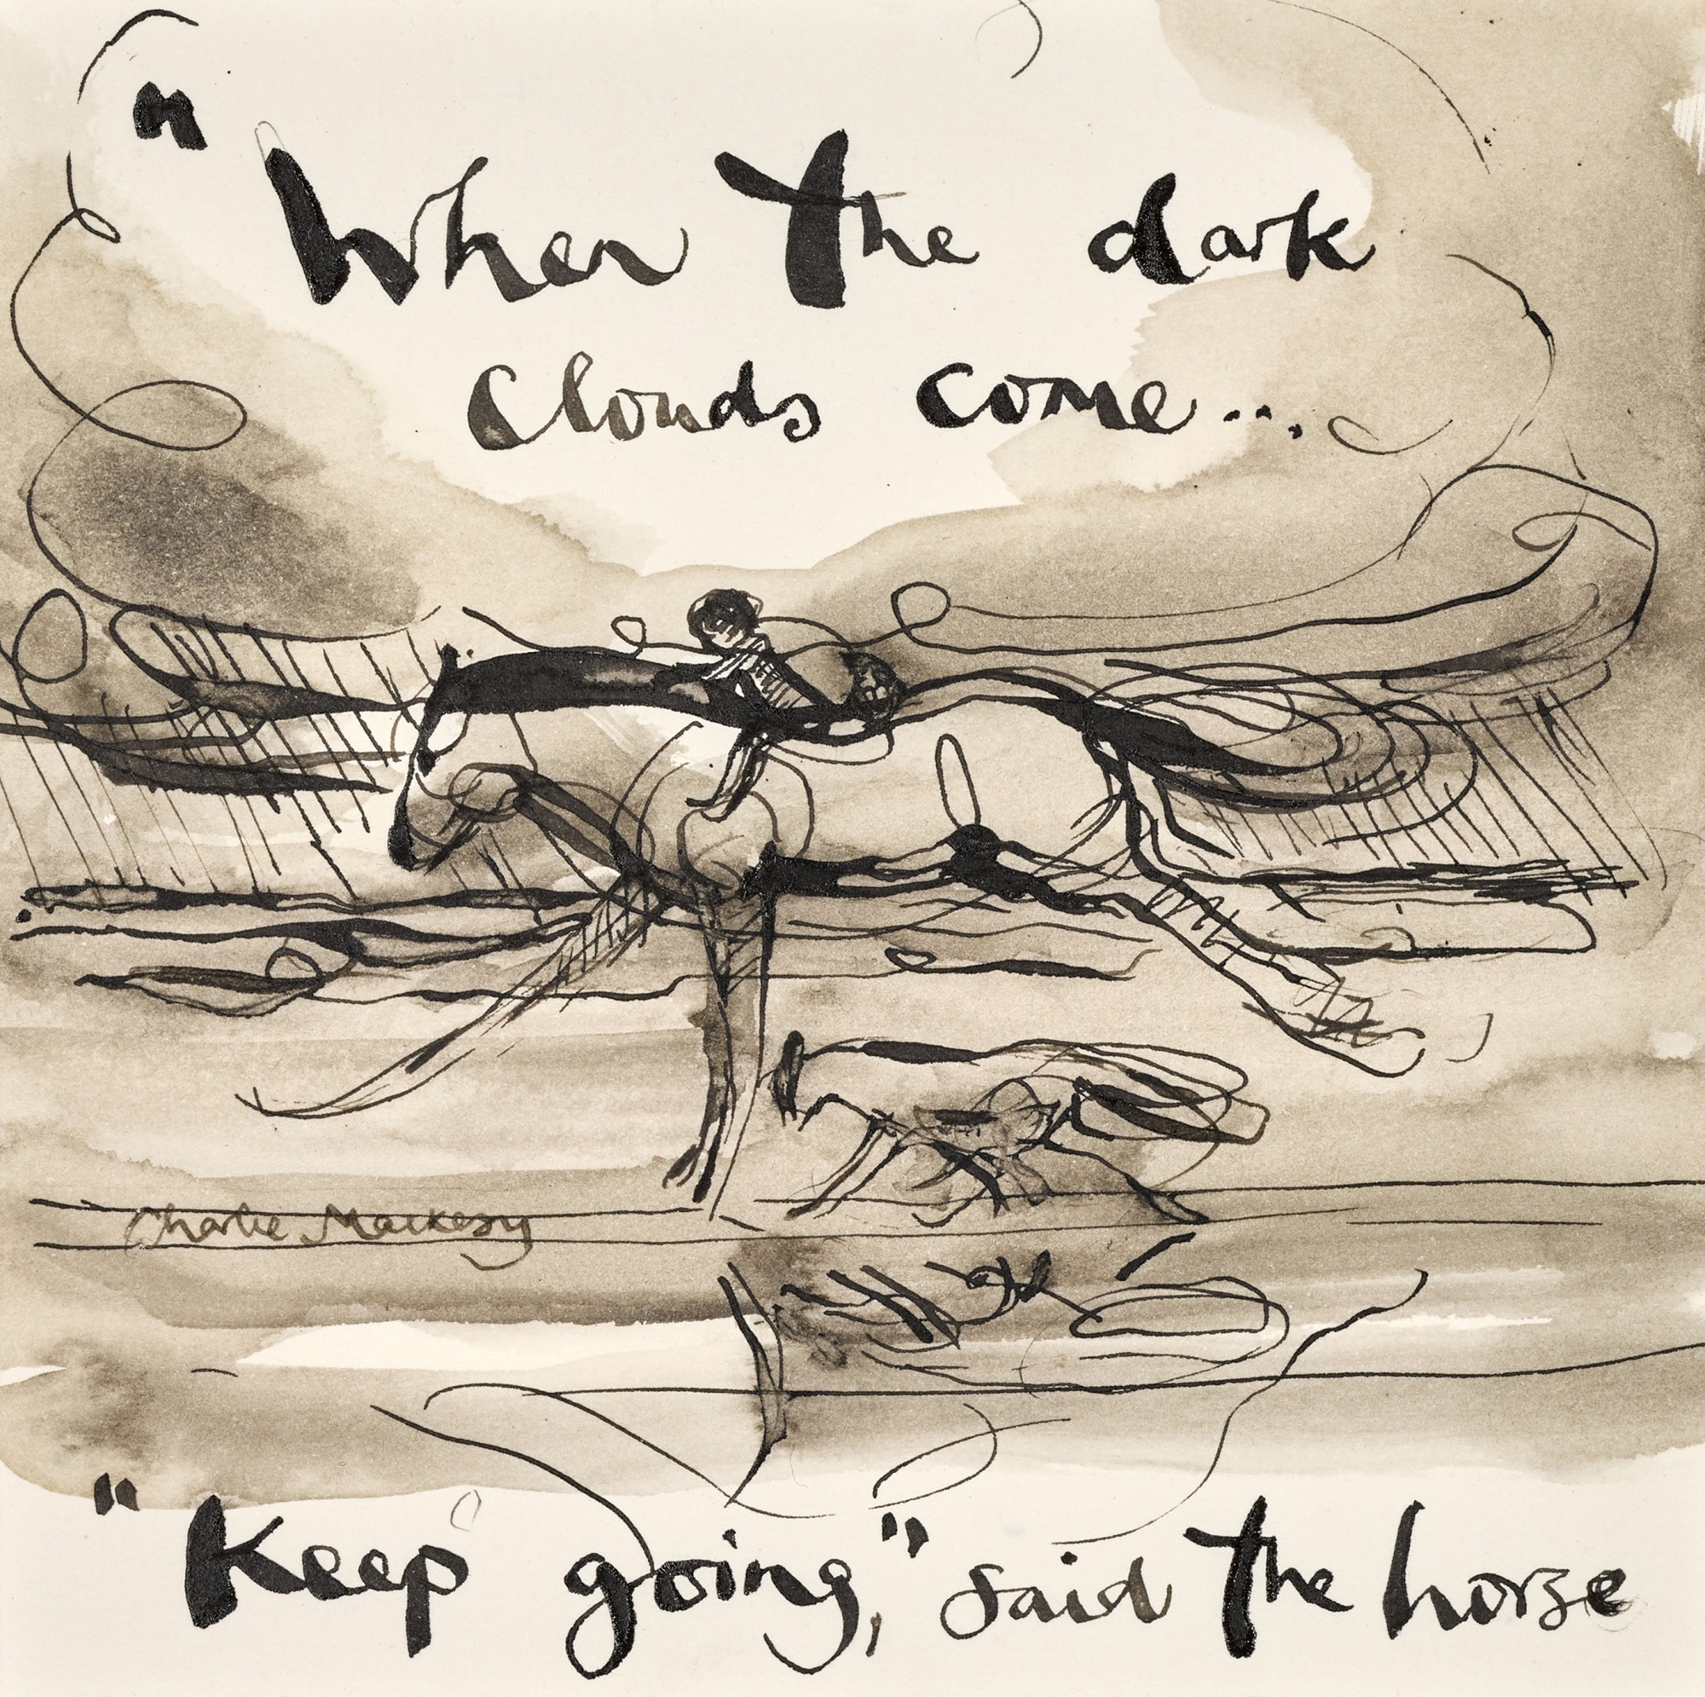
For The Journey: Suffering

Slide 2
‘We all share one thing in common. In our lives there will be winds that blow. Headwinds of difficulty brought on by our own decisions and gale-force winds of adversity due to circumstances that we never saw coming.’
‘Never Too Far’ - Louie Giglio

Slide 3
‘Then Job replied:
“Even today my complaint is bitter;
his hand is heavy in spite of my groaning.
If only I knew where to find him;
if only I could go to his dwelling!
I would state my case before him
and fill my mouth with arguments.”
Job 23 v 1-4

Slide 4
“But if I go to the east, he is not there;
if I go to the west, I do not find him.
When he is at work in the north, I do not see him;
when he turns to the south, I catch no glimpse of him.
But he knows the way that I take;
when he has tested me, I will come forth as gold.
My feet have closely followed his steps;
I have kept to his way without turning aside.
I have not departed from the commands of his lips;
I have treasured the words of his mouth more than my daily bread.”
Job 23 v 8-12

Slide 5
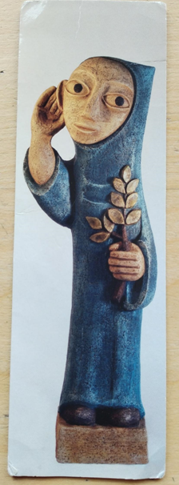
Saint Benedict -
The Listening Saint

Slide 6
“But if I go to the east, he is not there;
if I go to the west, I do not find him.
When he is at work in the north, I do not see him;
when he turns to the south, I catch no glimpse of him.”
Job 23 v 8-9

Slide 7
“My feet have closely followed his steps;
I have kept to his way without turning aside.
I have not departed from the commands of his lips;
I have treasured the words of his mouth more than my daily bread.”
Job 23 v 11-12

Slide 8
‘Blessed are those whose strength is in you,
who have set their heart on pilgrimage.
As they pass through the Valley of Baca,
they make it a place of springs.’
Psalm 84 v 5-6

Slide 9
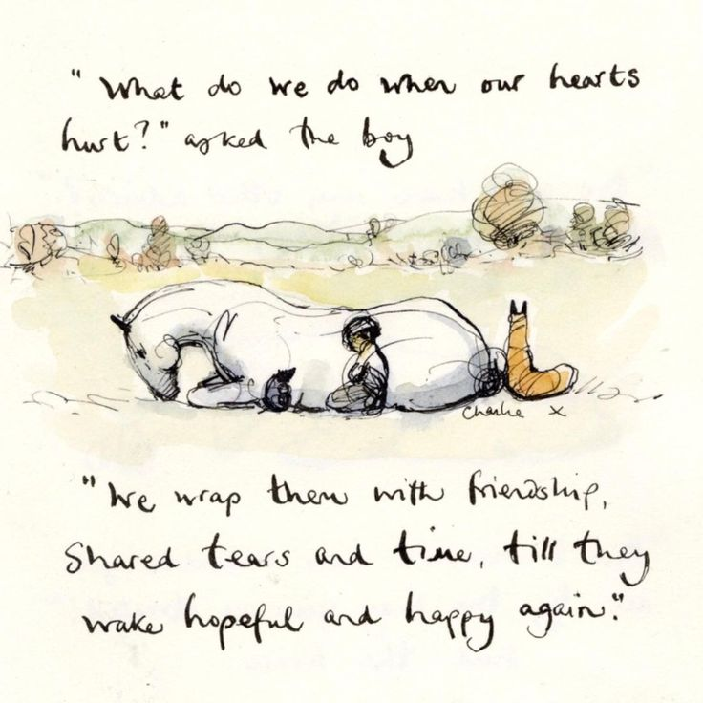

Slide 10
‘The key to recovery is to see there is a flicker of light, no matter how dark things may feel.’
Quote from Ebe’s Mental Health & Well-Being board

