Slide 1
VISION SUNDAY

Slide 2
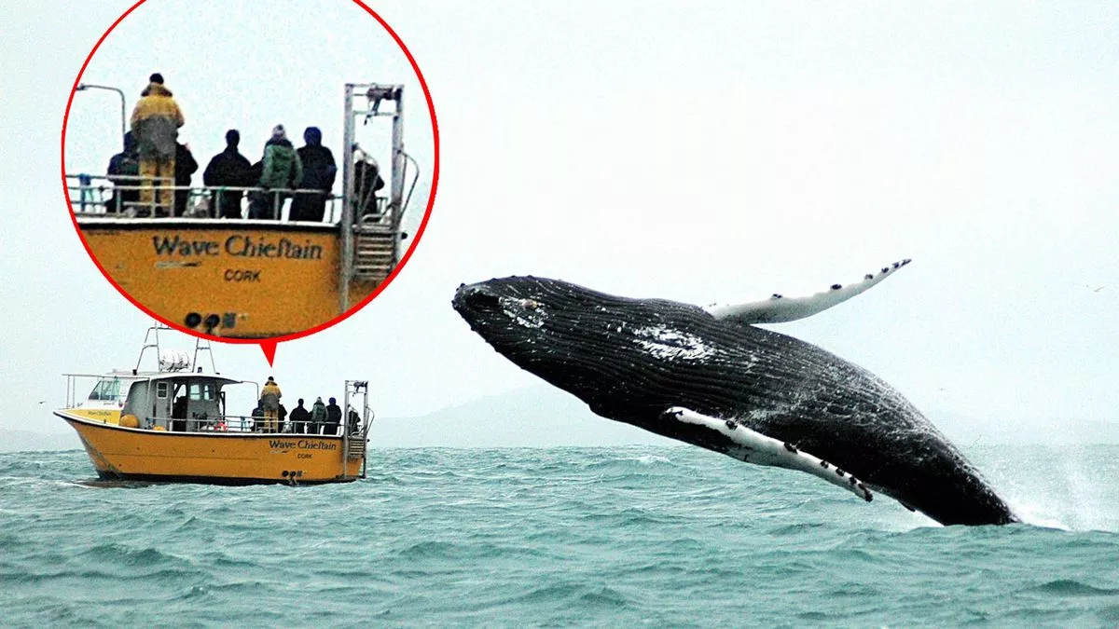

Slide 3
“Vision without action is merely a dream.
Action without vision just passes the time.
Vision with action can change the world.”
(Joel Barker, author)

Slide 4
“If people can’t see what God is doing, they stumble all over themselves; But when they attend to what he reveals, they are most blessed.”
(Proverbs 29:18, The Message translation of the Bible)

Slide 5
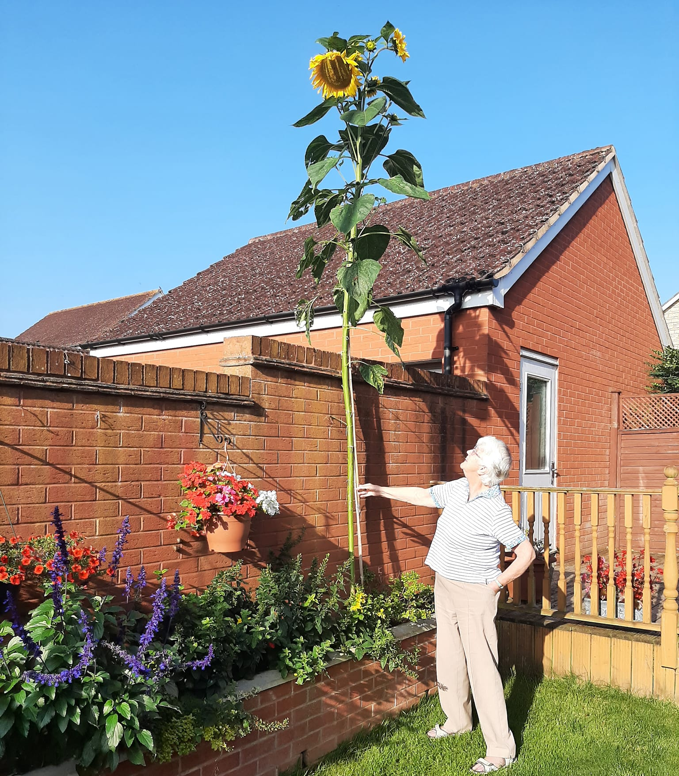

Slide 7
“Then Samuel took a stone and set it up between Mizpah and Shen.
He named it Ebenezer, saying, ‘Thus far the Lord has helped us.’”
(1 Samuel 7:12)

Slide 8
“Then Samuel took a stone and set it up between Mizpah and Shen.
He named it Ebenezer, saying, ‘Thus far the Lord has helped us.’”
(1 Samuel 7:12)
“The Lord will guide you always; he will satisfy your needs in a
sun-scorched land and will strengthen your frame. You will be like
a well-watered garden, like a spring whose waters never fail. Your people will rebuild the ancient ruins and will raise up the
age-old foundations; you will be called Repairer of Broken Walls, Restorer of Streets with Dwellings.”
(Isaiah 58:11-12)

Slide 9
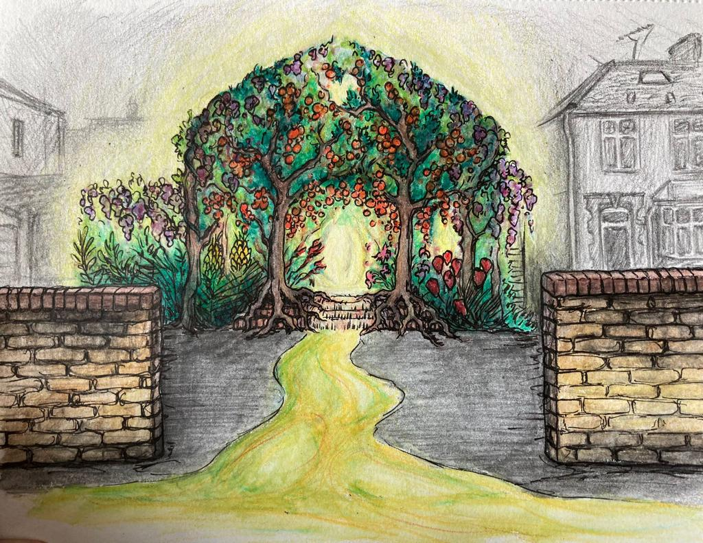
“You will be like a well-watered garden,
like a spring whose waters never fail.” (Isaiah 58: 11)

Slide 11
Welcoming everyone & sharing Jesus in our local communities.
Equipping & investing in our children, youth, & young adults.
Committed to supporting physical, emotional, mental and spiritual well-being.
Establish Ebe Church building as a Community Hub in Horfield.

Slide 12
Welcoming everyone & sharing Jesus in our local communities.

Slide 13
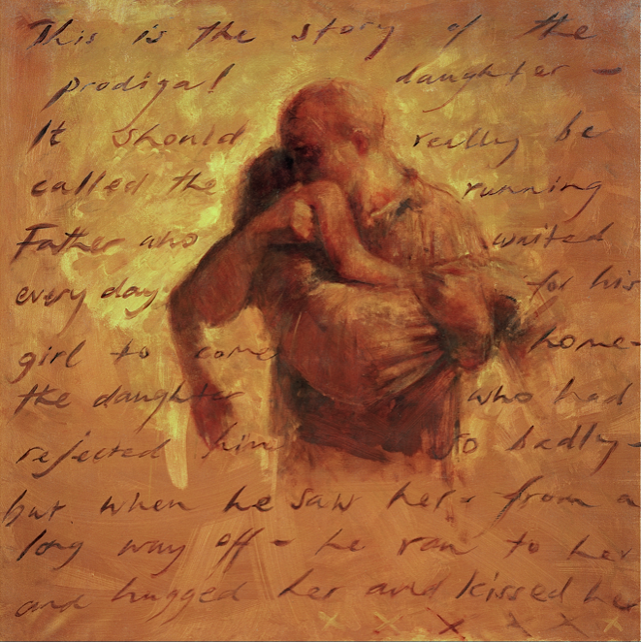
Welcoming everyone & sharing Jesus in our local communities.
Picture of Prodigal son from Luke 15
painted by Charlie Mackesy

Slide 14
Welcoming everyone & sharing Jesus in our local communities.
Equipping & investing in our children, youth, & young adults.

Slide 15
Welcoming everyone & sharing Jesus in our local communities.
Equipping & investing in our children, youth, & young adults.
Committed to supporting physical, emotional, mental and spiritual well-being.

Slide 16
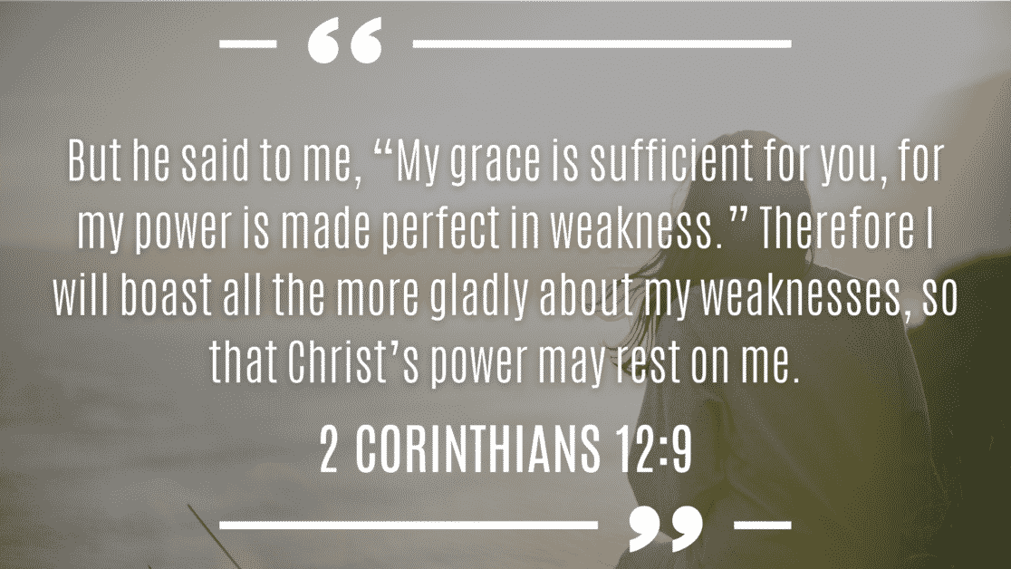
Welcoming everyone & sharing Jesus in our local communities.
Equipping & investing in our children, youth, & young adults.
Committed to supporting physical, emotional, mental and spiritual well-being.

Slide 17
Welcoming everyone & sharing Jesus in our local communities.
Equipping & investing in our children, youth, & young adults.
Committed to supporting physical, emotional, mental and spiritual well-being.
Establish Ebe Church building as a Community Hub in Horfield.

Slide 18
“like a well-watered garden, like a spring whose waters never fail…”
(Isaiah 58:11)
our relationship with God,
with each other
and with our communities.
Welcoming everyone & sharing Jesus in our local communities.
Equipping & investing in our children, youth, & young adults.
Committed to supporting physical, emotional, mental and spiritual well-being.
Establish Ebe Church building as a Community Hub in Horfield.

