Slide 1
JOHN IIXX–IXX JESUS+PILATE

Slide 2
Then the Jewish leaders took Jesus from Caiaphas to the palace of the Roman governor. By now it was early morning, and to avoid ceremonial uncleanness they did not enter the palace, because they wanted to be able to eat the Passover. So Pilate came out to them and asked, “What charges are you bringing against this man?”
“If he were not a criminal,” they replied, “we would not have handed him over to you.”
Pilate said, “Take him yourselves and judge him by your own law.” “But we have no right to execute anyone,” they objected. This took place to fulfill what Jesus had said about the kind of death he was going to die.
Pilate then went back inside the palace, summoned Jesus and asked him, “Are you the king of the Jews?”
“Is that your own idea,” Jesus asked, “or did others talk to you about me?”
“Am I a Jew?” Pilate replied. “Your own people and chief priests handed you over to me. What is it you have done?”

Slide 3
Jesus said, “My kingdom is not of this world. If it were, my servants would fight to prevent my arrest by the Jewish leaders. But now my kingdom is from another place.”
“You are a king, then!” said Pilate.
Jesus answered, “You say that I am a king. In fact, the reason I was born and came into the world is to testify to the truth. Everyone on the side of truth listens to me.”
“What is truth?” retorted Pilate. With this he went out again to the Jews gathered there and said, “I find no basis for a charge against him. But it is your custom for me to release to you one prisoner at the time of the Passover. Do you want me to release ‘the king of the Jews’?”
They shouted back, “No, not him! Give us Barabbas!” Now Barabbas had taken part in an uprising.
Then Pilate took Jesus and had him flogged. The soldiers twisted together a crown of thorns and put it on his head.

Slide 4
They clothed him in a purple robe and went up to him again and again, saying, “Hail, king of the Jews!” And they slapped him in the face.
Once more Pilate came out and said to the Jews gathered there, “Look, I am bringing him out to you to let you know that I find no basis for a charge against him.” When Jesus came out wearing the crown of thorns and the purple robe, Pilate said to them, “Here is the man!”
As soon as the chief priests and their officials saw him, they shouted, “Crucify! Crucify!”
But Pilate answered, “You take him and crucify him. As for me, I find no basis for a charge against him.”
The Jewish leaders insisted, “We have a law, and according to that law he must die, because he claimed to be the Son of God.”
When Pilate heard this, he was even more afraid, and he went back inside the palace. “Where do you come from?” he asked Jesus, but Jesus gave him no answer. “Do you refuse to speak to me?” Pilate said. “Don’t you realize I have power either to free you or to crucify you?”

Slide 5
Jesus answered, “You would have no power over me if it were not given to you from above. Therefore the one who handed me over to you is guilty of a greater sin.”
From then on, Pilate tried to set Jesus free, but the Jewish leaders kept shouting, “If you let this man go, you are no friend of Caesar. Anyone who claims to be a king opposes Caesar.”
When Pilate heard this, he brought Jesus out and sat down on the judge’s seat at a place known as the Stone Pavement (which in Aramaic is Gabbatha). It was the day of Preparation of the Passover; it was about noon.
“Here is your king,” Pilate said to the Jews.
But they shouted, “Take him away! Take him away! Crucify him!” “Shall I crucify your king?” Pilate asked.
“We have no king but Caesar,” the chief priests answered.
Finally Pilate handed him over to them to be crucified.

Slide 6
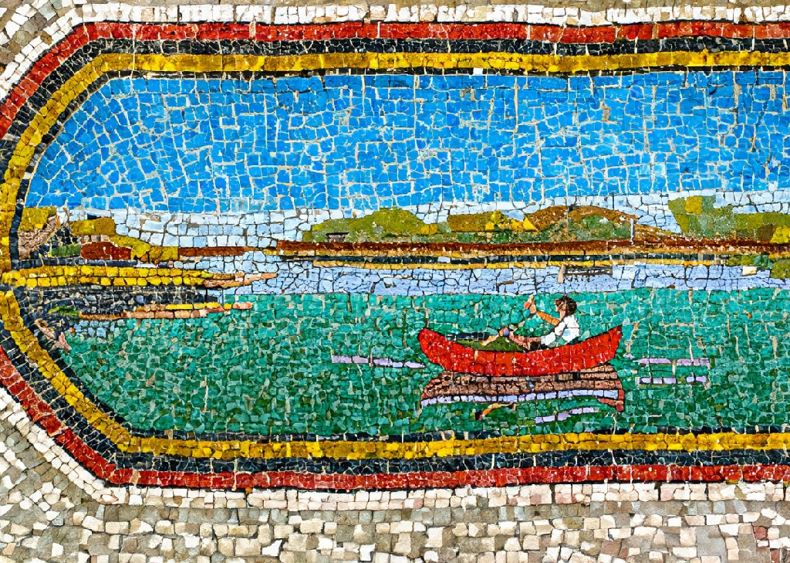
PILATE WANTS STEADY SHIPS

Slide 7
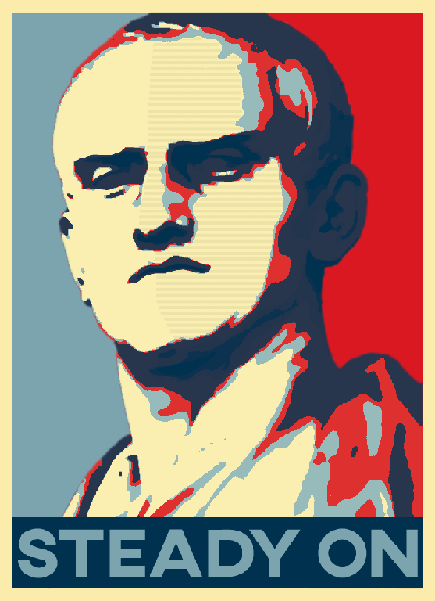

Slide 9
FULL STEAM AHEAD
MIGHT IS RIGHT
OPPRESSIVE OCCUPATION RUTHLESS MILITARISM GRASPING FOR POWER
ELITES+PAUPERS
NEPOTISTIC DESPOTS

Slide 10
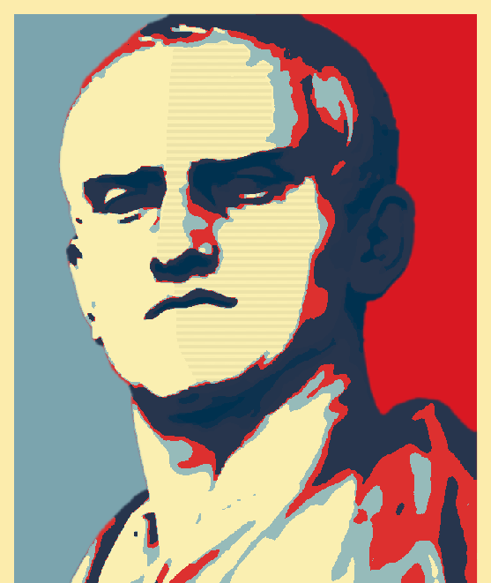
DON’ T ROCK THE
BO AT !!!

Slide 11
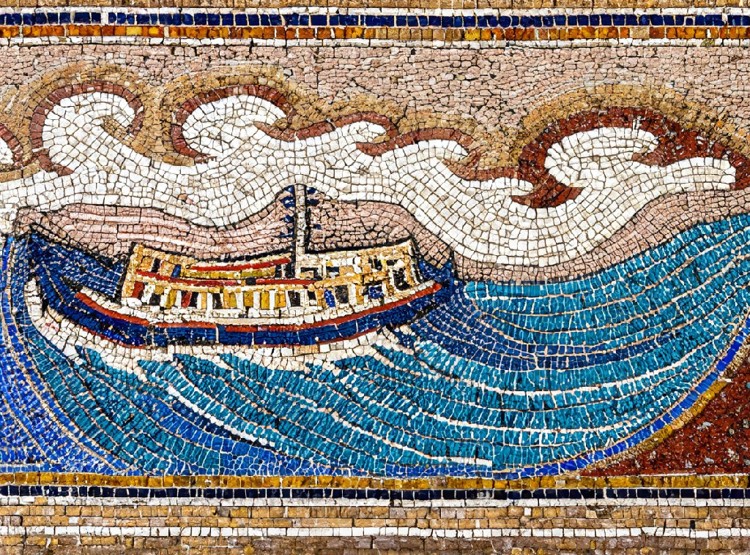
GOD’ S WAY ROCKS BOATS

Slide 12
GOD IS
NOT
NEUTRAL

Slide 13
You levy a straw tax on the poor and impose a tax on their grain.
Therefore, though you have built stone mansions, you will not live in them;
though you have planted lush vineyards, you will not drink their wine.
For I know how many are your offenses and how great your sins…
Woe to you who long for the day of the Lord!
Why do you long for the day of the Lord?
That day will be darkness, not light.

Slide 14
It will be as though a man fled from a lion only to meet a bear,
as though he entered his house and rested his hand on the wall only to have a snake bite him.
Will not the day of the Lord be darkness, not light— pitch-dark, without a ray of brightness?
“I hate, I despise your religious festivals; your assemblies are a stench to me.
Even though you bring me burnt offerings and grain offerings,
I will not accept them.
Though you bring choice fellowship offerings, I will have no regard for them.
Away with the noise of your songs!
I will not listen to the music of your harps.
But let justice roll on like a river, righteousness like a never-failing stream!

Slide 15
He has brought down rulers from their thrones but has lifted up the humble.
He has filled the hungry with good things but has sent the rich away empty.

Slide 16
“Blessed are the poor in spirit,
for theirs is the kingdom of heaven.
Blessed are those who mourn, for they will be comforted.
Blessed are the meek,
for they will inherit the earth.
Blessed are those who hunger and thirst for righteousness,
for they will be filled. Blessed are the merciful,
for they will be shown mercy.
Blessed are the pure in heart, for they will see God.
Blessed are the peacemakers,
for they will be called children of God.
Blessed are those who are persecuted because of righteousness, for theirs is the kingdom of heaven.

Slide 17
When it was almost time for the Jewish Passover, Jesus went up to Jerusalem. In the temple courts he found people selling cattle, sheep and doves, and others sitting at tables exchanging money. So he made a whip out of cords, and drove all from the temple courts, both sheep and cattle; he scattered the coins of the money changers and overturned their tables. To those who sold doves he said, “Get these out of here! Stop turning my Father’s house into a market!”

Slide 18
They came to Capernaum. When he was in the house, he asked them, “What were you arguing about on the road?” But they kept quiet because on the way they had argued about who was the greatest.
Sitting down, Jesus called the Twelve and said, “Anyone who wants to be first must be the very last, and the servant of all.” He took a little child whom he placed among them. Taking the child in his arms, he said to them, “Whoever welcomes one of these little children in my name welcomes me; and whoever welcomes me does not welcome me but the one who sent me.”

Slide 19
“Whoever wants to be my disciple must deny themselves and take up their cross daily and follow me. For whoever wants to save their life will lose it, but whoever loses their life for me will save it. What good is it for someone to gain the whole world, and yet lose or forfeit their very self?”

Slide 20
“Woe to you, teachers of the law and Pharisees, you hypocrites! You shut the door of the kingdom of heaven in people’s faces. You yourselves do not enter, nor will you let those enter who are trying to.
“Woe to you, teachers of the law and Pharisees, you hypocrites! You give a tenth of your spices—mint, dill and cumin. But you have neglected the more important matters of the law—justice, mercy and faithfulness. You should have practiced the latter, without neglecting the former. You blind guides! You strain out a gnat but swallow a camel.”

Slide 21
Do nothing out of selfish ambition or vain conceit. Rather, in humility value others above yourselves, not looking to your own interests but each of you to the interests of the others.
In your relationships with one another, have the same mindset as Christ Jesus:
Who, being in very nature God,
did not consider equality with God something to be used to his own advantage;
rather, he made himself nothing
by taking the very nature of a servant

Slide 22
Then I saw a Lamb, looking as if it had been slain, standing at the center of the throne, encircled by the four living creatures and the elders.

Slide 23
GOD’ S BOAT- ROCKING WAYS
FIRST IS LAST
SOLIDARITY WITH THE VOICELESS+OVERLOOKED
GRACE MERCY FORGIVENESS LOVE DRIVING OUT FEAR
SERVICE OVER POWER GENEROSITY OVER GAIN

Slide 24
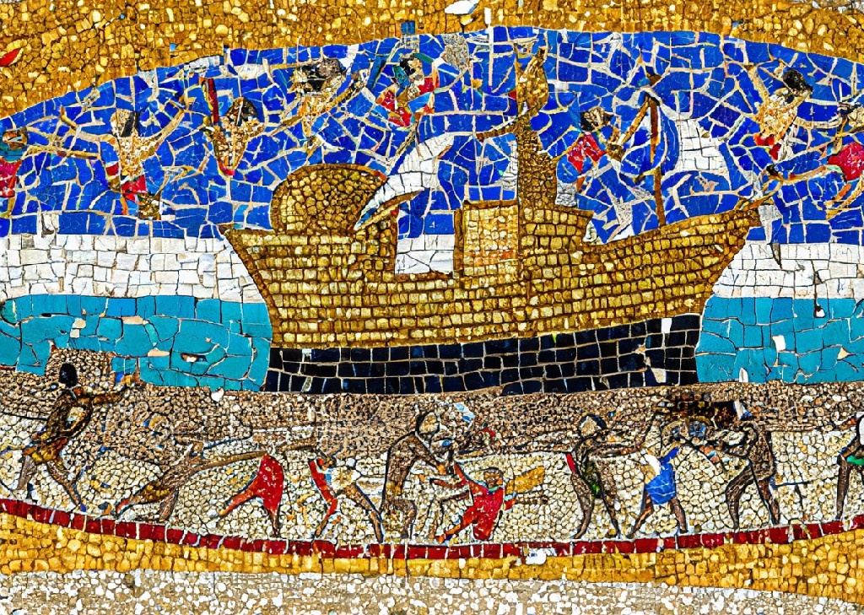
OUR BOAT NEEDS ROCKING

Slide 25
Where you
see these
things
Resist them

Slide 26
MIGHT IS RIGHT
OPPRESSIVE OCCUPATION RUTHLESS MILITARISM GRASPING FOR POWER
ELITES+PAUPERS
NEPOTISTIC DESPOTS TOTAL INDIVIDUALISM
RELENTLESS GROWTH

Slide 27
GREED IS GOOD PROFIT OVER ALL
EXTRACTION OVER SUSTAINABILITY
SHORT- TERM COMFORT OVER ONGOING EQUITY WA RMAKING OVER
PEACEMAKING

Slide 28
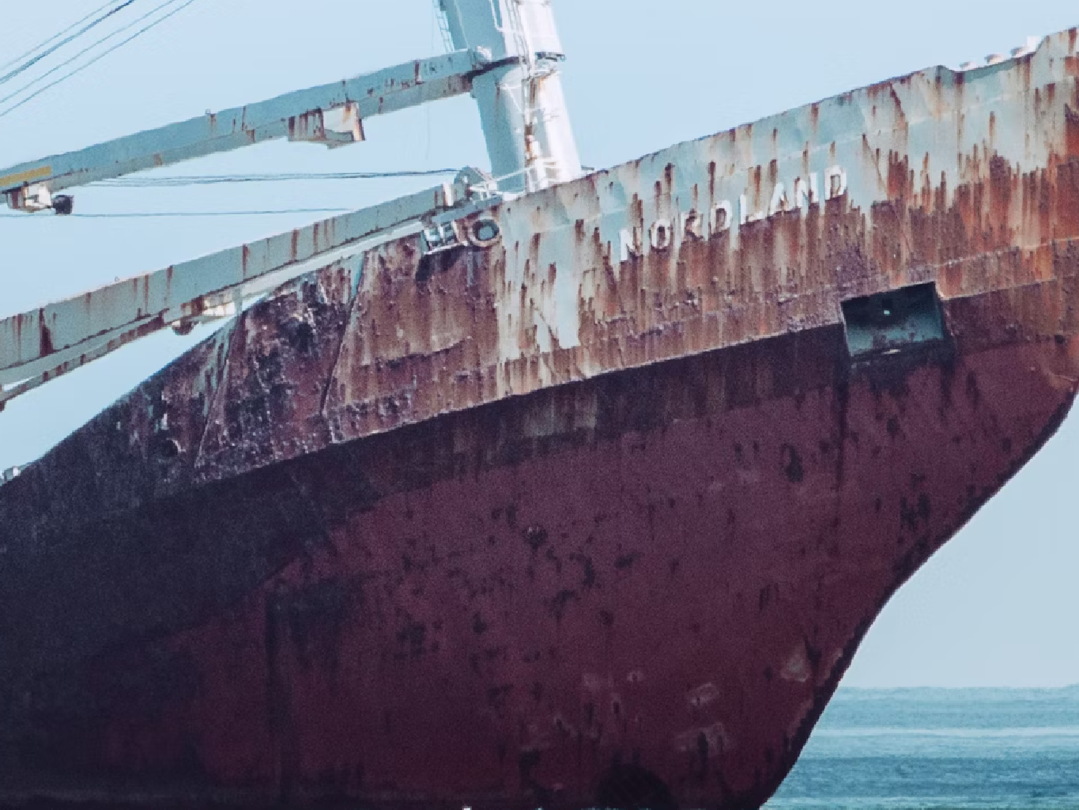
ROYAL
CONSCIOUSNESS

Slide 29
ZERO
SUM
GAME

Slide 30
DOG
EAT
DOG

Slide 31
OPPRESSIVE
EXPANSIONIST
COLONIALISM

Slide 32
RAMPANT
INDIVIDUALISTIC
SCARCITY-
RIVALRY

Slide 33
RACIST
PATRIARCHAL
OTHERING
OLIGARCHY

Slide 34
EXPLOITATIVE
SUPREMACIST
VIOLENCE-
BACKED
CONQUEST

Slide 35
ARTIFICIALLY DIVIDING THE
POOR AGAINST ONE
ANOTHER TO LEAVE THE
RICH AND POWERFUL TO
RUN WILD UNCHALLENGED

Slide 36
RANDIAN
FREE-MARKET
CAPITALISM

Slide 37
JUST
STRAIGHT-UP
GREED

Slide 38
X
JESUS’ VISION
FOR HUMAN
FLOURISHING

Slide 39
MIGHT IS RIGHT
OPPRESSIVE OCCUPATION RUTHLESS MILITARISM GRASPING FOR POWER
ELITES+PAUPERS
NEPOTISTIC DESPOTS TOTAL INDIVIDUALISM
RELENTLESS GROWTH

Slide 40
GREED IS GOOD PROFIT OVER ALL
EXTRACTION OVER SUSTAINABILITY
SHORT- TERM COMFORT OVER ONGOING EQUITY WA RMAKING OVER
PEACEMAKING

Slide 41
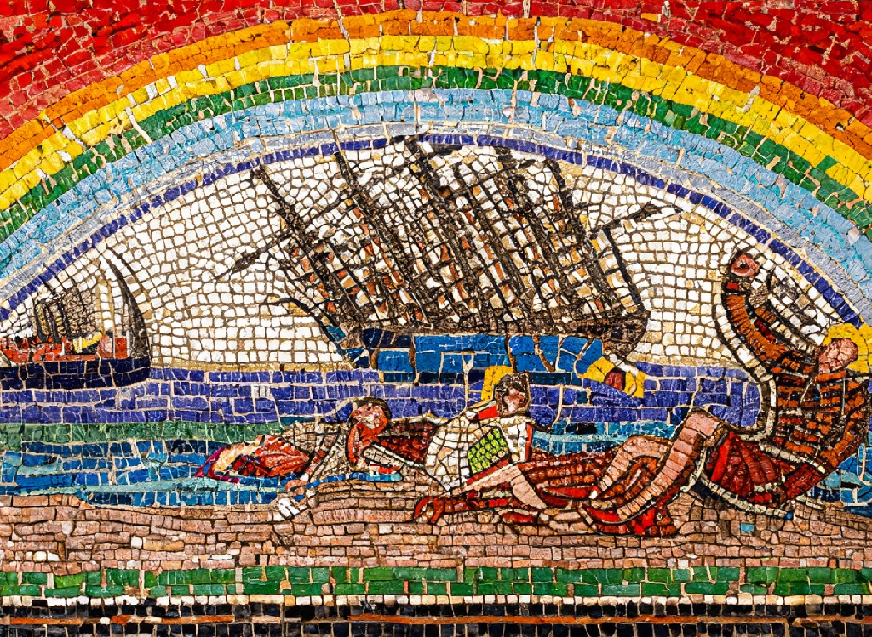
SMALL CAPSIZINGS EVERYWHERE DAILY

Slide 42
Not being able to
do everything
doesn t mean we
can t do anything

Slide 43
X
DON’ T ROCK THE
BO AT !!!

