Slide 1
The vision is Jesus

Slide 2
John 1:1-5
1 In the beginning was the Word, and the Word was with God, and the Word was God. 2 He was with God in the beginning. 3 Through him all things were made; without him nothing was made that has been made. 4 In him was life, and that life was the light of all mankind. 5 The light shines in the darkness, and the darkness has not overcome it.

Slide 3
14 The Word became flesh and made his dwelling among us. We have seen his glory, the glory of the one and only Son, who came from the Father, full of grace and truth.
15 (John (the Baptist) testified concerning him. He cried out, saying, ‘This is the one I spoke about when I said, “He who comes after me has surpassed me because he was before me.”’) 16 Out of his fullness we have all received grace in place of grace already given. 17 For the law was given through Moses; grace and truth came through Jesus Christ. 18 No one has ever seen God, but the one and only Son, who is himself God and is in the closest relationship with the Father, has made him known.

Slide 4
The Vision is Jesus…
God is a community of love
Invitation to real love
Partnership

Slide 5
God is a community of love
1 In the beginning was the Word, and the Word was with God, and the Word was God. 2 He was with God in the beginning.

Slide 6
God is a community of love
Jesus is God
V18 No one has ever seen God, but the one and only Son, who is himself God and is in the closest relationship with the Father, has made him known.

Slide 7
God is a community of love
Jesus is God
V18 No one has ever seen God, but the one and only Son, who is himself God and is in the closest relationship with the Father, has made him known.
deepest reality is that God is a community of love …we call The Trinity

Slide 8
Invitation to real love
V18 No one has ever seen God, but ….has made him known.
John 17: 26 Jesus says to the Father “ I have made you known to them, and will continue to make you known in order that the love you have for me may be in them and that I myself may be in them.’

Slide 9
Invitation to real love
I said to the man who stood at the gate of the year:
‘Give me a light that I may tread safely into the unknown.’
And he replied:
‘Go out into the darkness and put your hand into the Hand of God.
That shall be to you better than light and safer than a known way.’
So I went forth, and finding the Hand of God, trod gladly into the night.
And He led me towards the hills and the breaking of day in the lone East. (Minnie Louise Haskins)

Slide 10
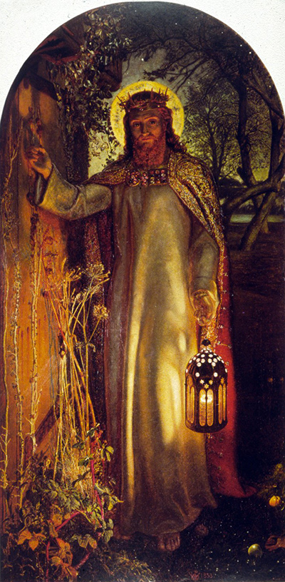
Revelation 3:20 “behold I stand at the door and knock, if anyone hears my voice and opens the door, I will come in to him and eat with him and he with me”

Slide 11
Partnership
V14 The Word became flesh and made his dwelling among us.

Slide 12
Partnership
1 V14 The Word became flesh and made his dwelling among us.
17:21‘Peace be with you! As the Father has sent me, I am sending you.’
17:22 And with that he breathed on them and said, ‘Receive the Holy Spirit.

Slide 13
The vision is Jesus
God is love is the deepest reality of all that is
Invitation to love …this deepest reality is for all of us ...all the time…behold Jesus stands at the door and knocks…
Partnership …not on our own but with his Spirit …putting our hands in God’s hand into the new year

