Slide 1
The Start

Slide 2
The Start
A journey with God to know more of God
Why Start?…
How?...Series
Suffering
Stumbling

Slide 3
PSALM 84
1 How lovely is your dwelling-place,
LORD Almighty!
2 My soul yearns, even faints,
for the courts of the LORD;
my heart and my flesh cry out
for the living God.
3 Even the sparrow has found a home,
and the swallow a nest for herself,
where she may have her young –
a place near your altar,
LORD Almighty, my King and my God.

Slide 4
4 Blessed are those who dwell in your house;
they are ever praising you.[c]
5 Blessed are those whose strength is in you,
whose hearts are set on pilgrimage.
6 As they pass through the Valley of Baka,
they make it a place of springs;
the autumn rains also cover it with pools.[d]
7 They go from strength to strength,
till each appears before God in Zion.

Slide 5
8 Hear my prayer, LORD God Almighty;
listen to me, God of Jacob.
9 Look on our shield,[e] O God;
look with favour on your anointed one.
10 Better is one day in your courts
than a thousand elsewhere;
I would rather be a doorkeeper in the house of my God
than dwell in the tents of the wicked.

Slide 6
11 For the LORD God is a sun and shield;
the LORD bestows favour and honour;
no good thing does he withhold
from those whose way of life is blameless.
12 LORD Almighty,
blessed is the one who trusts in you.

Slide 7
A journey with God to know more of God
Why Start?…

Slide 8
A journey with God to know more of God
Why Start?…
For the LORD God is a sun and shield;
the LORD bestows favour and honour;
no good thing does he withhold
from those whose way of life is blameless.
12 LORD Almighty,
blessed is the one who trusts in you.

Slide 9
A journey with God to know more of God
Why Start?…
Paul Philippians 3
I want to know Christ, the power of his resurrection and the fellowship of sharing in his sufferings.

Slide 10
Philippians 3
12 Not that I have already obtained all this, or have already arrived at my goal, but I press on to take hold of that for which Christ Jesus took hold of me. 13 Brothers and sisters, I do not consider myself yet to have taken hold of it. But one thing I do: Forgetting what is behind and straining toward what is ahead, 14 I press on toward the goal to win the prize for which God has called me heavenward in Christ Jesus.

Slide 11
A journey with God to know more of God
Why Start?…
10 Better is one day in your courts
than a thousand elsewhere;
I would rather be a doorkeeper in the house of my God
than dwell in the tents of the wicked.

Slide 12
How do the journey?...
Follow the series

Slide 13
How do the journey?...
Suffering
we need to keep going through the hard times…this is where God does his deepest work in our lives.

Slide 14
How do the journey?...
Suffering
5 Blessed are those whose strength is in you,
whose hearts are set on pilgrimage.
6 As they pass through the Valley of Baka,
they make it a place of springs;
the autumn rains also cover it with pools.

Slide 15
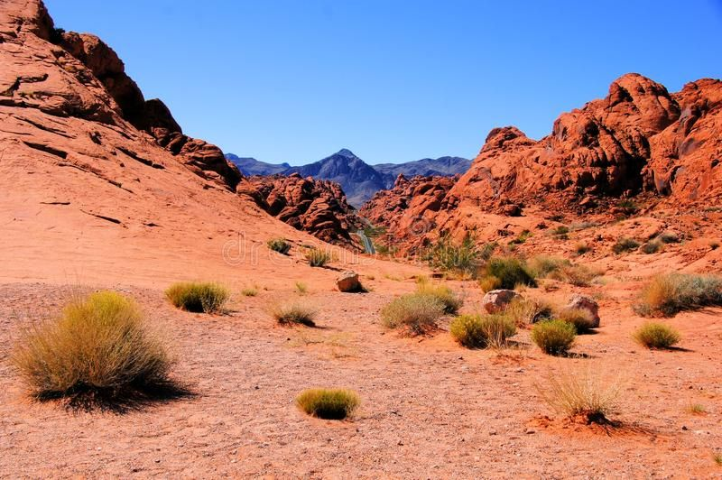
Suffering

Slide 16
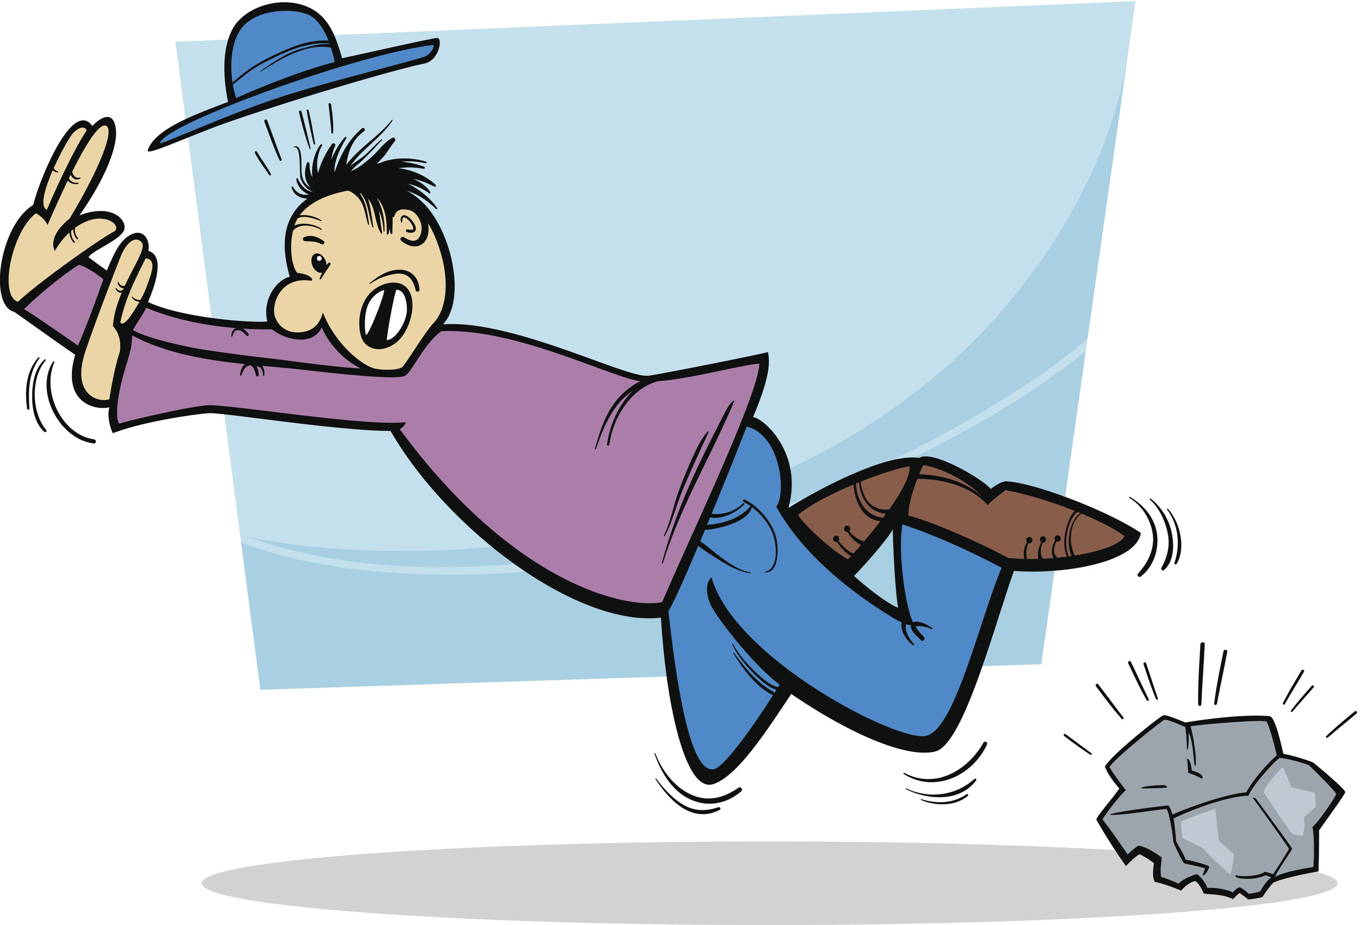
How do the journey?...
Stumbling

Slide 17
How do the journey?...
Stumbling
God also works with the honest or real and those who in their hearts want to follow him

Slide 18
How do the journey?...
Stumbling
All sunshine and sovereign is GOD,
generous in gifts and glory.
He doesn’t scrimp with his traveling companions.
It’s smooth sailing all the way with GOD-of-the-Angel-Armies.

Slide 19
How do the journey?...
Hebrews 4 :14 Therefore, since we have a great high priest who has ascended into heaven,[f] Jesus the Son of God, let us hold firmly to the faith we profess. 15 For we do not have a high priest who is unable to feel sympathy for our weaknesses,.. 16 Let us then approach God’s throne of grace with confidence, so that we may receive mercy and find grace to help us in our time of need.

Slide 20
A journey with God to know more of God
“unless the truths of Jesus are combined with the ways of Jesus we will not experience the life of Jesus.”
Eugene Peterson

Slide 21
A journey with God to know more of God
11 For the LORD God is a sun and shield;
the LORD bestows favour and honour;
no good thing does he withhold
from those whose way of life is blameless.
12 LORD Almighty,
blessed is the one who trusts in you.

