Slide 1
Helpful Habits: Reading Scripture, and Prayer
Why?
How?
What helpful daily habits do you have that enable you to keep going through your day?

Slide 2
Deuteronomy 4:1-14
Now, Israel, hear the decrees and laws I am about to teach you. Follow them so that you may live and may go in and take possession of the land the Lord, the God of your ancestors, is giving you. ² Do not add to what I command you and do not subtract from it, but keep the commands of the Lord your God that I give you. ³ You saw with your own eyes what the Lord did at Baal Peor. The Lord your God destroyed from among you everyone who followed the Baal of Peor, ⁴ but all of you who held fast to the Lord your God are still alive today. ⁵ See, I have taught you decrees and laws as the Lord my God commanded me, so that you may

Slide 3
follow them in the land you are entering to take possession of it. ⁶ Observe them carefully, for this will show your wisdom and understanding to the nations, who will hear about all these decrees and say, “Surely this great nation is a wise and understanding people.” ⁷ What other nation is so great as to have their gods near them the way the Lord our God is near us whenever we pray to him? ⁸ And what other nation is so great as to have such righteous decrees and laws as this body of laws I am setting before you today? ⁹ Only be careful, and watch yourselves closely so that you do not forget the things your eyes have seen or let them fade from your heart as long as you live. Teach them to your children and to their children after them.

Slide 4
¹⁰ Remember the day you stood before the Lord your God at Horeb, when he said to me, “Assemble the people before me to hear my words so that they may learn to revere me as long as they live in the land and may teach them to their children.” ¹¹ You came near and stood at the foot of the mountain while it blazed with fire to the very heavens, with black clouds and deep darkness. ¹² Then the Lord spoke to you out of the fire. You heard the sound of words but saw no form; there was only a voice. ¹³ He declared to you his covenant, the Ten Commandments, which he commanded you to follow and then wrote them on two stone tablets. ¹⁴ And the Lord directed me at that time to teach you the decrees and laws you are to follow in the land that you are crossing the Jordan to possess.

Slide 5
Joshua 1:7-9
⁷ “Be strong and very courageous. Be careful to obey all the law my servant Moses gave you; do not turn from it to the right or to the left, that you may be successful wherever you go. ⁸ Keep this Book of the Law always on your lips; meditate on it day and night, so that you may be careful to do everything written in it. Then you will be prosperous and successful. ⁹ Have I not commanded you? Be strong and courageous. Do not be afraid; do not be discouraged, for the Lord your God will be with you wherever you go.”

Slide 6
Why read scripture?
So we can know God and be like Jesus
Christian= Little Christ/ little Jesus
“Now, Israel, hear the decrees and laws I am about to teach you. Follow them…”.
“Keep this Book of the Law always on your lips; meditate on it day and night so that you may be careful to do everything written in it.

Slide 7
Why pray?
To connect with God
What does prayer look like for you?
Connection, Commitment, Thankfulness, Spending time with God, A source of Comfort, Wishing the best for things/people, Seeking God’s wisdom and understanding.
Choosing to communicate with God

Slide 8
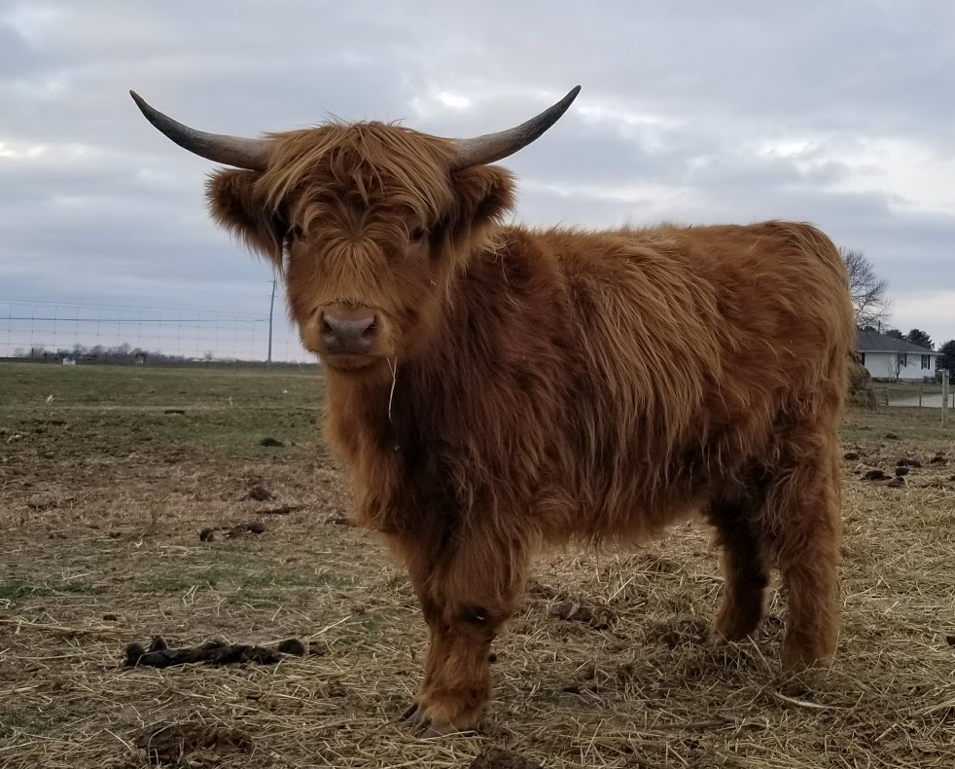
Reading Scripture: How? Like a Cow!

Slide 9
Prayer: How?
Talk/Sing
Write
Draw/paint
Dance
Play an instrument
Be still
Etc

