Slide 1
The Church at Colossae

Slide 3
The Church at Colossae
Why Trust in Jesus?

Slide 4
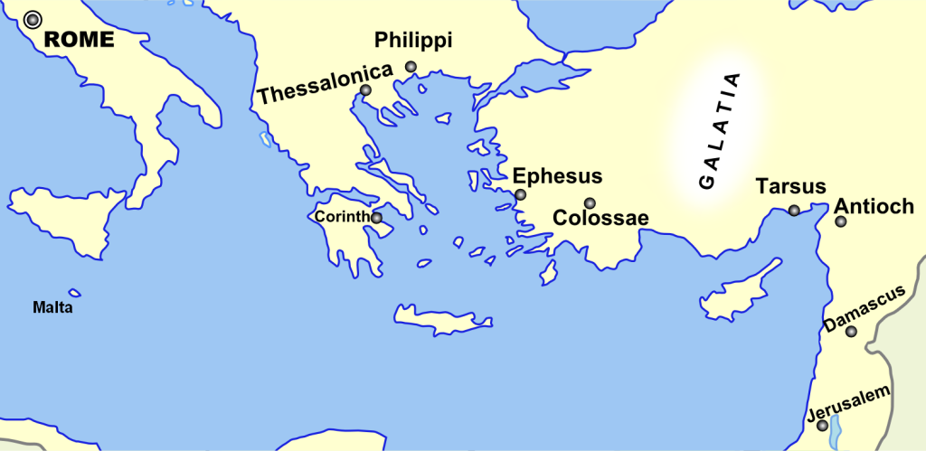

Slide 5
Colossians Chapter one
1 Paul, an apostle of Christ Jesus by the will of God, and Timothy our brother,
² To God’s holy people in Colossae, the faithful brothers and sisters^{[a]} in Christ:
Grace and peace to you from God our Father.

Slide 6
3 We always thank God, the Father of our Lord Jesus Christ, when we pray for you, 4 because we have heard of your faith in Christ Jesus and of the love you have for all God’s people – 5 the faith and love that spring from the hope stored up for you in heaven and about which you have already heard in the true message of the gospel 6 that has come to you.

Slide 7
In the same way, the gospel is bearing fruit and growing throughout the whole world – just as it has been doing among you since the day you heard it and truly understood God’s grace. 7 You learned it from Epaphras, our dear fellow servant,[c] who is a faithful minister of Christ on our[d] behalf, 8 and who also told us of your love in the Spirit.

Slide 8
Why have faith in Jesus?
Event
Effective
Ebe

Slide 9
Why have faith in Jesus?
“the faith and love that spring from the hope stored up for you in heaven and about which you have already heard in the true message of the gospel 6 that has come to you”

Slide 10
Why have faith in Jesus?
Hope based on an Event
The Gospel a secular word based on history making event

Slide 11
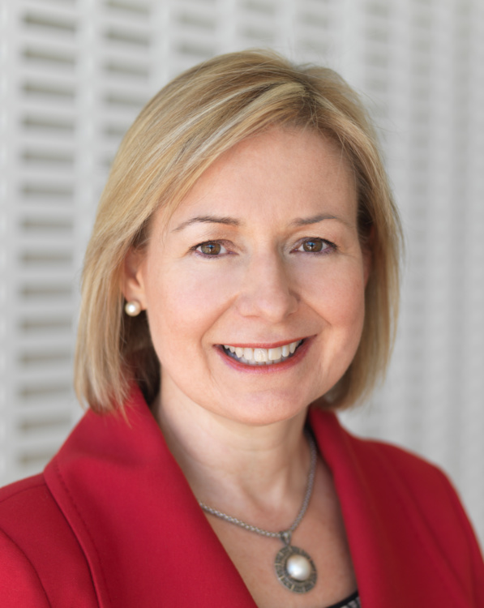
Rosalind Wright Picard
“I became somebody who started to believe not only in the possibility that God existed, but maybe it was more probable than not.”

Slide 12
CS Lewis
The deep joy Lewis experienced in literature and mythology was not an illusion but had a source. The stories that seemed most meaningful to him were not lies but contained the seeds of truth that were fulfilled in the life, death, and resurrection of Jesus."

Slide 13
Why have faith in Jesus?
A certain hope based on an Event
Effective
“In the same way, the gospel is bearing fruit and growing throughout the whole world”

Slide 14
Why have faith in Jesus?
Effective
Third of world
test of time
fruitful

Slide 15
Why have faith in Jesus?
Event
Effective
Ebe

Slide 16
How to have effective faith in Jesus
Materialism…identity in Christ
Individualism…community
Consumerism…servant

Slide 17
Ebe The church that meets at 286 Filton Avenue…
Can we say
We have heard of your faith in Christ Jesus and of the love you have for all God’s people – ⁵ the faith and love that spring from the hope stored up for you in heaven

