Slide 1
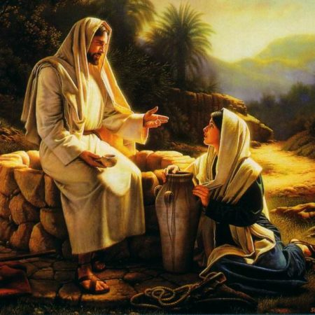
Jesus and … the Samaritan Woman… John 4:1-42

Slide 2
“Jesus performed many other signs in the presence of his disciples, which are not recorded in this book. But these are written that you may believe that Jesus is the Messiah, the Son of God, and that by believing you may have life in his name.” John 20:30-31

Slide 3
“Jesus performed many other signs in the presence of his disciples, which are not recorded in this book. But these are written that you may believe that Jesus is the Messiah, the Son of God, and that by believing you may have life in his name.” John 20:30-31
“Come! See a man who told me everything I ever did. Could this be the Messiah?” John 4:29

Slide 4
Jesus meets us where we are,
not where we think we ought to be.

Slide 5
Jesus meets us where we are,
not where we think we ought to be.
Jesus meets us in our day to day circumstances - and lifts us above them

Slide 6
Jesus meets us where we are,
not where we think we ought to be.
Jesus meets us in our day to day circumstances - and lifts us above them
Jesus meets us in our failure – and transforms us.

Slide 8
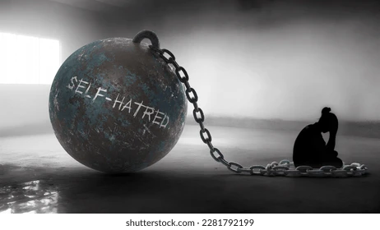

Slide 10
“whoever drinks the water I give them will never thirst. Indeed, the water I give them will become in them a spring of water welling up to eternal life.” John 4: 14

Slide 11
“Satan’s greatest trick and his real temptation is to get you to wallow on the ground defining you by your most recent failure when God continues to define you by his grace.” (Tylor Staton)

Slide 12
“whoever drinks the water I give them will never thirst. Indeed, the water I give them will become in them a spring of water welling up to eternal life.” John 4: 14

