Slide 1
The great Paradox
Religion is not the answer to our spiritual need.
Under the cover of night, Jesus shed light on Nicodemus’s greatest need – to be born again.
The conversation in John 3, helps us understand the light of salvation that Jesus shines on Humanity.
Notes:
The Darkness of today’s world alarms us as uncertainly, violence, sin, fragility, and vulnerability surround us. Humanity’s darkness threatens our joy, contentment, and hope for the future. Sometimes we choose physical or metaphorical darkness to hide what we don’t want others to see, know, or believe about us. We might even try to hide from God, who sees and knows all.
God responded to our need in a glorious way: Jesus Christ, the light of the world, left heaven’s glory to dispel darkness. Under the cover of night, Jesus shed light on Nicodemus’s greatest need – to be born again. This conversation helps us understand the light of salvation that Jesus shines on Humanity.

Slide 2
3 Now there was a Pharisee, a man named Nicodemus who was a member of the Jewish ruling council. ² He came to Jesus at night and said, “Rabbi, we know that you are a teacher who has come from God. For no one could perform the signs you are doing if God were not with him.”
³ Jesus replied, “Very truly I tell you, no one can see the kingdom of God unless they are born again.”

Slide 3
⁴ “How can someone be born when they are old?” Nicodemus asked. “Surely they cannot enter a second time into their mother’s womb to be born!”
⁵ Jesus answered, “Very truly I tell you, no one can enter the kingdom of God unless they are born of water and the Spirit. ⁶ Flesh gives birth to flesh, but the Spirit gives birth to spirit. ⁷ You should not be surprised at my saying, ‘You must be born again.’

Slide 4
⁸ The wind blows wherever it pleases. You hear its sound, but you cannot tell where it comes from or where it is going. So it is with everyone born of the Spirit.”
⁹ “How can this be?” Nicodemus asked.
¹⁰ “You are Israel’s teacher,” said Jesus, “and do you not understand these things?

Slide 5
¹¹ Very truly I tell you, we speak of what we know, and we testify to what we have seen, but still you people do not accept our testimony. ¹² I have spoken to you of earthly things and you do not believe; how then will you believe if I speak of heavenly things? ¹³ No one has ever gone into heaven except the one who came from heaven—the Son of Man.

Slide 6
¹⁴ Just as Moses lifted up the snake in the wilderness, so the Son of Man must be lifted up, ¹⁵ that everyone who believes may have eternal life in him.”
¹⁶ For God so loved the world that he gave his one and only Son, that whoever believes in him shall not perish but have eternal life. ¹⁷ For God did not send his Son into the world to condemn the world, but to save the world through him.

Slide 7
¹⁸ Whoever believes in him is not condemned, but whoever does not believe stands condemned already because they have not believed in the name of God’s one and only Son. ¹⁹ This is the verdict: Light has come into the world, but people loved darkness instead of light because their deeds were evil.

Slide 8
²⁰ Everyone who does evil hates the light, and will not come into the light for fear that their deeds will be exposed. ²¹ But whoever lives by the truth comes into the light, so that it may be seen plainly that what they have done has been done in the sight of God.

Slide 9
“How can this be?” Paradox – Persistent contradiction, a statement that runs contrary to one's expectation, “Unity of opposites”
Nicodemus – religious elite yet empty/spiritually dead
“3 Now there was a Pharisee, a man named Nicodemus who was a member of the Jewish ruling council. ² He came to Jesus at night….”
Notes:
a statement that runs contrary to one's expectation
A paradox usually involves contradictory-yet-interrelated elements that exist simultaneously and persist over time. They result in "persistent contradiction between interdependent elements" leading to a lasting "unity of opposites".

Slide 10
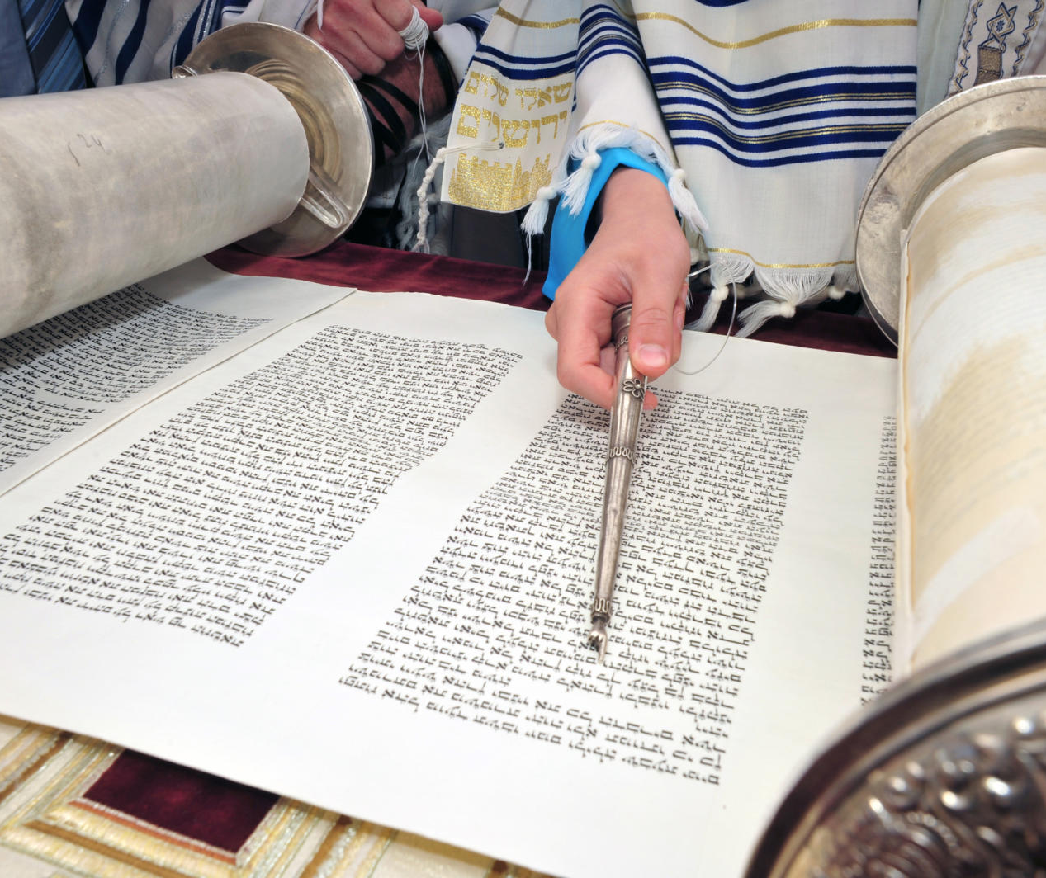
Jewish Ruling Council = Sanhedrin
71 members
Expert in Hebrew law
Pharisees – especially oral tradition
613 distinct laws
How are we like Nicodemus, following all the rules but spiritually empty?
Notes:
Pharisees were members of a party that believed in resurrection and in following legal traditions that were ascribed not to the Bible but to “the traditions of the fathers.” Like the scribes, they were also well-known legal experts: hence the partial overlap of membership of the two groups.

Slide 11
“How can this be?” Paradox – Persistent contradiction, a statement that runs contrary to one's expectation, “Unity of opposites”
Nicodemus – religious elite yet empty/spiritually dead
Jesus – of God but not “one of them”
“Rabbi, we know that you are a teacher who has come from God. For no one could perform the signs you are doing if God were not with him.”
Notes:
a statement that runs contrary to one's expectation
A paradox usually involves contradictory-yet-interrelated elements that exist simultaneously and persist over time. They result in "persistent contradiction between interdependent elements" leading to a lasting "unity of opposites".

Slide 12
“How can this be?” Paradox – Persistent contradiction, a statement that runs contrary to one's expectation, “Unity of opposites”
Nicodemus – religious elite yet empty/spiritually dead
Jesus – of God but not “one of them”
Re-born when your old
³ Jesus replied, “Very truly I tell you, no one can see the kingdom of God unless they are born again.”
⁴ “How can someone be born when they are old?” Nicodemus asked. “Surely they cannot enter a second time into their mother’s womb to be born!”
Notes:
⁴ “How can someone be born when they are old?” Nicodemus asked. “Surely they cannot enter a second time into their mother’s womb to be born!”
⁵ Jesus answered, “Very truly I tell you, no one can enter the kingdom of God unless they are born of water and the Spirit. ⁶ Flesh gives birth to flesh, but the Spirit gives birth to spirit. ⁷ You should not be surprised at my saying, ‘You must be born again.’

Slide 13
“How can this be?” Paradox – Persistent contradiction, a statement that runs contrary to one's expectation, “Unity of opposites”
Nicodemus – religious elite yet empty/spiritually dead
Jesus – of God but not “one of them”
Re-born when your old
Physical ”Flesh” vs Spiritual
Wind – invisible/uncontrollable yet heard and movement seen
“Very truly I tell you, no one can enter the kingdom of God unless they are born of water and the Spirit. ⁶ Flesh gives birth to flesh, but the Spirit gives birth to spirit.”
Notes:
a statement that runs contrary to one's expectation
A paradox usually involves contradictory-yet-interrelated elements that exist simultaneously and persist over time. They result in "persistent contradiction between interdependent elements" leading to a lasting "unity of opposites".

Slide 14
“How can this be?” Paradox – Persistent contradiction, a statement that runs contrary to one's expectation, “Unity of opposites”
Nicodemus – religious elite yet empty/spiritually dead
Jesus – of God but not “one of them”
Re-born when your old
Physical ”Flesh” vs Spiritual
Wind – invisible/uncontrollable yet heard and movement seen
^{“8} The wind blows wherever it pleases. You hear its sound, but you cannot tell where it comes from or where it is going. So it is with everyone born of the Spirit.”
Notes:
Jesus explained the difference between being born of flesh and the spirit. Being born of “Flesh” points to physical birth in a physical body, which includes our will, thoughts and emotions. The fall to sin, left all flesh subject to temptation, weakness, sin and death. Being born again, spiritually, means his redeemed children receive a new will to live for him. Wind – Spirit – same word. Unseen but powerful force. The Holy Spirit “Wind” enables those who become a new creation in Christ, to see God’s Kingdom. God given Spiritual eyesight. That God has delivered them “into the Kingdom of the Son he loves. The Spirit gives eternal life and an unending relationship with God that cannot be reversed.

Slide 15
“How can this be?” Paradox – Persistent contradiction, a statement that runs contrary to one's expectation, “Unity of opposites”
Nicodemus – religious elite yet empty/spiritually dead
Jesus – of God but not “one of them”
Re-born when your old
Physical ”Flesh” vs Spiritual
Wind – invisible/uncontrollable yet heard and movement seen
Earthly vs Heavenly
¹² I have spoken to you of earthly things and you do not believe; how then will you believe if I speak of heavenly things?
Notes:
Despite his vast knowledge, Nicodemus was perplexed – How can this be? Despite his extensive learning, he remained blinded by unbelief. He was blind to the plain declaration of Scripture. In contrast to his disciples – unschooled, simple fisherman, who had the faith to follow Jesus, Nicodemus knew the law, but lacked the eyes of faith. Jesus reaches back to two striking prophesies pointing to Jesus power and authority, and centrality to salvation.

Slide 16
“Son of Man”
Daniel 7:13-14
“In my vision at night I looked, and there before me was one like a son of man, coming with the clouds of heaven. He approached the Ancient of Days and was led into his presence. ¹⁴ He was given authority, glory and sovereign power; all nations and peoples of every language worshipped him. His dominion is an everlasting dominion that will not pass away, and his kingdom is one that will never be destroyed.”
Notes:
Jesus – the “Son of Man” God himself, taking on flesh and blood. The unthinkable – scandalous – but through this obedience was given absolute reign and authority.

Slide 17
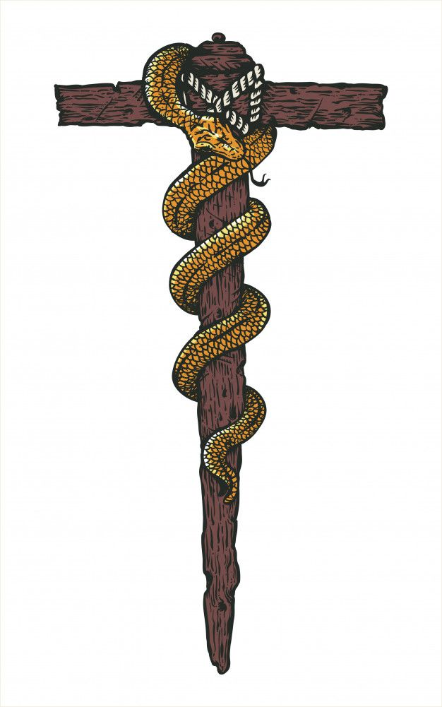
“Just as Moses lifted up the snake in the wilderness…”
Notes:
A cursed thing becomes and object of mercy
Moses Bronze Snake in the Wilderness (Num 21:6-9) – a symbol of healing even today – the snake on a pole – medical professionals (CADUCEUS)
The redemptive work of the cross. Jesus became sin for us, that we might receive salvation. Physical deliverance, healing, by looking at the symbol of death. A look of Faith!

Slide 18
“How can this be?” Paradox – Persistent contradiction, a statement that runs contrary to one's expectation, “Unity of opposites”
Nicodemus – religious elite yet empty/spiritually dead
Jesus – of God but not “one of them”
Re-born when your old
Physical ”Flesh” vs Spiritual
Wind – invisible/uncontrollable yet heard and movement seen
Earthly vs Heavenly
Light vs Darkness
Notes:
a statement that runs contrary to one's expectation
A paradox usually involves contradictory-yet-interrelated elements that exist simultaneously and persist over time. They result in "persistent contradiction between interdependent elements" leading to a lasting "unity of opposites".

Slide 19
“How can this be?” Paradox – Persistent contradiction, a statement that runs contrary to one's expectation, “Unity of opposites”
Nicodemus – religious elite yet empty/spiritually dead
Jesus – of God but not “one of them”
Re-born when your old
Physical ”Flesh” vs Spiritual
Wind – invisible/uncontrollable yet heard and movement seen
Earthly vs Heavenly
Love for the world = “Gave” Death of beloved only son
^{“16} For God so loved the world that he gave his one and only Son, that whoever believes in him shall not perish but have eternal life.”
Notes:
a statement that runs contrary to one's expectation
A paradox usually involves contradictory-yet-interrelated elements that exist simultaneously and persist over time. They result in "persistent contradiction between interdependent elements" leading to a lasting "unity of opposites".

Slide 20
“How can this be?” Paradox – Persistent contradiction, a statement that runs contrary to one's expectation, “Unity of opposites”
Nicodemus – religious elite yet empty/spiritually dead
Jesus – of God but not “one of them”
Re-born when your old
Physical ”Flesh” vs Spiritual
Wind – invisible/uncontrollable yet heard and movement seen
Earthly vs Heavenly
Love for the world = “Gave” Death for beloved only son
Condemnation vs Salvation
Light vs Darkness
Notes:
Jesus intent was not condemnation but life.
Light from darkness

Slide 21
¹⁷ For God did not send his Son into the world to condemn the world, but to save the world through him. ¹⁸ Whoever believes in him is not condemned, but whoever does not believe stands condemned already because they have not believed in the name of God’s one and only Son. ¹⁹ This is the verdict: Light has come into the world, but people loved darkness instead of light because their deeds were evil.
Notes:
Jesus on the cross defeated death and condemnation. The ultimate demonstration of God’s mercy for humanity. To reject the gift of salvation through Jesus, means to receive second death. To stand condemned already means that you have rejected the only means for salvation – there is no one else to rescue you from your sin, and reconcile you to God – accept Jesus Christ. That is why you stand condemned already and will not stand victorious in judgement.

Slide 22
²⁰ Everyone who does evil hates the light, and will not come into the light for fear that their deeds will be exposed. ²¹ But whoever lives by the truth comes into the light, so that it may be seen plainly that what they have done has been done in the sight of God.
Notes:
To reject the light of the Gospel – Jesus good news - means you love darkness rather than light. Freedom from fear and condemnation means you still are hiding in the shame, guilt and

Slide 23
What happened to Nicodemus?
^{John 7:50} Nicodemus, who had gone to Jesus earlier and who was one of their own number, asked, ⁵¹ “Does our law condemn a man without first hearing him to find out what he has been doing?”
⁵² They replied, “Are you from Galilee, too? Look into it, and you will find that a prophet does not come out of Galilee.”
^{John 19:38} Later, Joseph of Arimathea asked Pilate for the body of Jesus. Now Joseph was a disciple of Jesus, but secretly because he feared the Jewish leaders. With Pilate’s permission, he came and took the body away. ³⁹ He was accompanied by Nicodemus, the man who earlier had visited Jesus at night. Nicodemus brought a mixture of myrrh and aloes, about seventy-five pounds.^{[e]} ⁴⁰ Taking Jesus’ body, the two of them wrapped it, with the spices, in strips of linen. This was in accordance with Jewish burial customs.

Slide 24
Application
What paradox of Jesus are you struggling with?
Striving yet unfulfilled
Do you find yourself pursuing the light or living in darkness?
Is your life a paradox – sinner saved by grace?
Is the power of the Spirit in your life conspicuous?

