Slide 1
Knowing we are loved

Slide 2
John 21:20 Peter turned and saw that the disciple whom Jesus loved was following them. (This was the one who had leaned back against Jesus at the supper and had said, ‘Lord, who is going to betray you?’) ²¹ When Peter saw him, he asked, ‘Lord, what about him?’
²² Jesus answered, ‘If I want him to remain alive until I return, what is that to you? You must follow me.’ ²³ Because of this, the rumour spread among the believers that this disciple would not die.

Slide 3
But Jesus did not say that he would not die; he only said, ‘If I want him to remain alive until I return, what is that to you?’ ²⁴ This is the disciple who testifies to these things and who wrote them down. We know that his testimony is true.
²⁵ Jesus did many other things as well. If every one of them were written down, I suppose that even the whole world would not have room for the books that would be written.

Slide 4
Knowing we are loved
Jesus and… John
Jesus and us
How can we know Love?

Slide 5
Jesus and… John “the disciple who Jesus loved”
Fisherman
Sons of Thunder
Judgmental
Power hungry

Slide 6
Jesus and… John “the disciple who Jesus loved”
Revelation 1:6 “to him who loves …to him be power and glory
Confident of Love…despite circumstances
Person of love…laying down his live…for others
Giving power to God…not grasping it for himself

Slide 7
Jesus and… John “the disciple who Jesus loved”

Slide 8
Jesus and… us

Slide 9
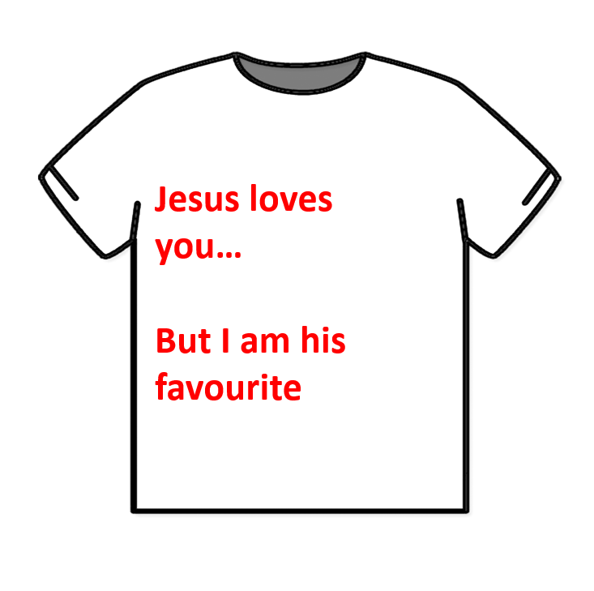

Slide 10
Jesus and… us
John not loved more but realized that he was loved
1 John “deeply loved ones” not “dear friends” as per NIV

Slide 11
How can we know love
Objective truth…set in time and history
Relational experience

Slide 12
How can we know love
Objective truth…set in time and history
Relational experience
Meditation on bible …immersing ourselves in the story

Slide 13
How can we know love
Rest in the presence of Jesus…all are welcome
As we come we too can know that we are the disciple that Jesus loves. That is our primary identity
We can become like John …in place of suffering
To him who loves us…to him be power and Glory

