Slide 1
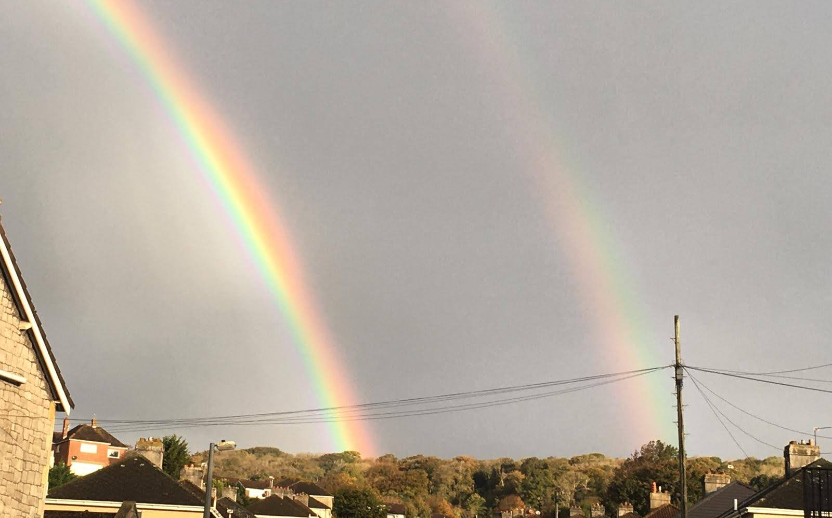
The Faithfulness of God
Caption

Slide 2
Psalm 36
5 Your love, Lord, reaches to the heavens,
your faithfulness to the skies.
6 Your righteousness is like the highest mountains,
your justice like the great deep.
You, Lord, preserve both people and animals.
7 How priceless is your unfailing love, O God!
People take refuge in the shadow of your wings.
Caption

Slide 3
Lamentations 3
19 I remember my affliction and my wandering, the bitterness and the gall.
20 I well remember them, and my soul is downcast within me.
21 Yet this I call to mind and therefore I have hope:
Caption

Slide 4
22 Because of the Lord’s great love we are not consumed, for his compassions never fail.
23 They are new every morning; great is your faithfulness.
24 I say to myself, “The Lord is my portion; therefore I will wait for him.”
Caption

Slide 5
Psalm 86
11 Teach me your way, Lord, that I may rely on your faithfulness; give me an undivided heart, that I may fear your name.
12 I will praise you, Lord my God, with all my heart; I will glorify your name forever.
13 For great is your love toward me; you have delivered me from the depths, from the realm of the dead.
Caption

Slide 6
14 Arrogant foes are attacking me, O God; ruthless people are trying to kill me— they have no regard for you.
15 But you, Lord, are a compassionate and gracious God, slow to anger, abounding in love and faithfulness.
16 Turn to me and have mercy on me; show your strength in behalf of your servant; save me, because I serve you just as my mother did.
Caption

Slide 7
Caption

Slide 8
Great, Your faithfulness
O God my Father, O God my friend
Your love it never fades And so I’ll love You until the end
When shadows fall, You never change, from age to age, You never change
Caption

Slide 9
Great is Your faithfulness Your faithfulness
Through the years You’ve always been there
Great is Your love for us Your love for us
Through the years You’ll always be there
Great, Your kindness God
You are our shelter our dwelling place
Your presence like a fire Hope for tomorrow strength for today
Caption

Slide 10
GREAT IS THY FAITHFULNESS, O God my Father,
There is no shadow of turning with Thee;
Thou changest not, Thy compassions, they fail not;
As Thou hast been Thou forever wilt be.
Great is Thy faithfulness!
Caption

Slide 11
Caption

Slide 12
God’s faithfulness isn’t about me.
God’s faithfulness is about the faithfulness of God.
Caption

Slide 13
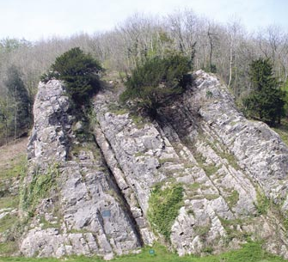
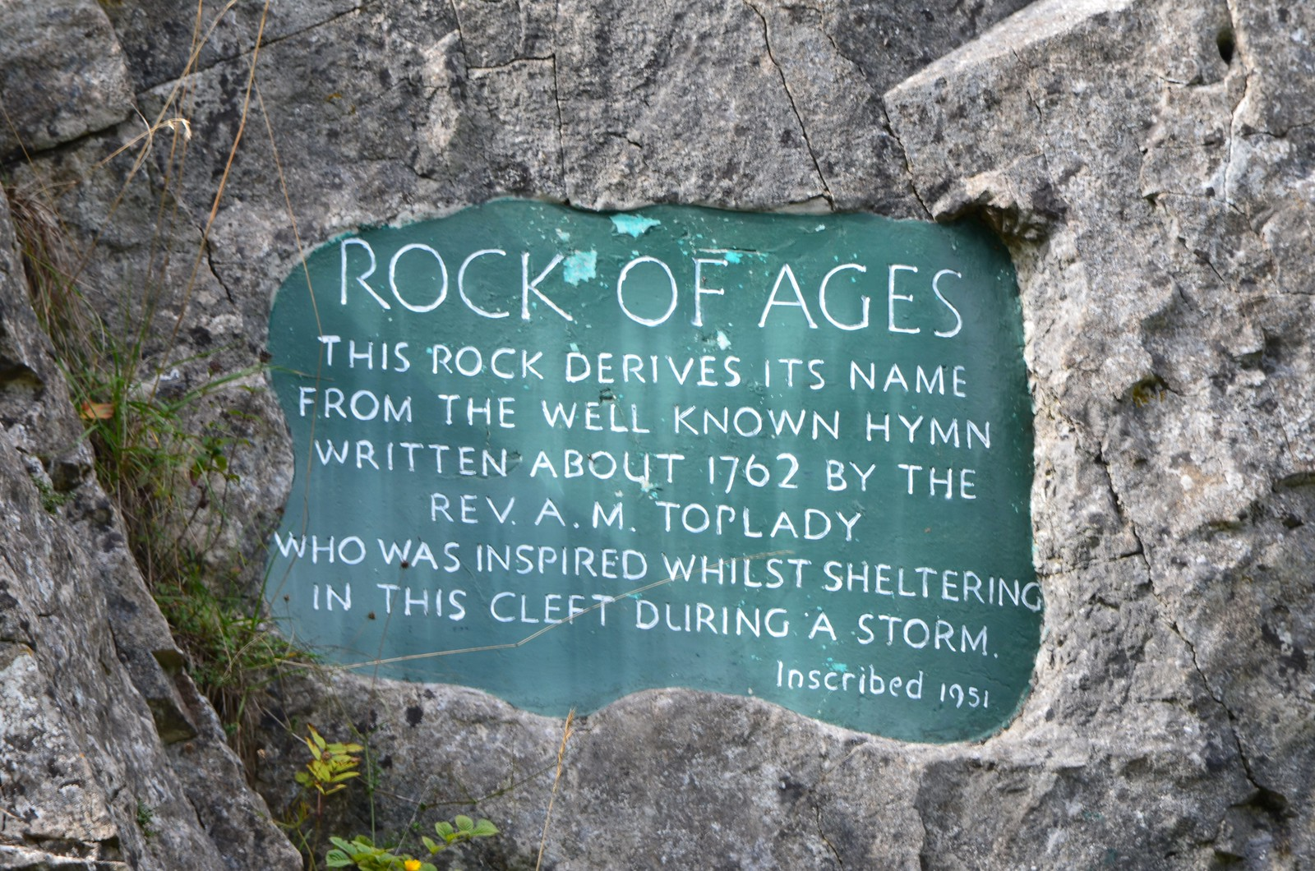
Caption

Slide 14
Ss
Caption

Slide 15
66 From this time many of his disciples turned back and no longer followed him.
67 “You do not want to leave too, do you?” Jesus asked the Twelve.
68 Simon Peter answered him, “Lord, to whom shall we go? You have the words of eternal life. 69 We have come to believe and to know that you are the Holy One of God.”
Caption

Slide 16
As I look into next year do I have faith in the faithfulness of God
Do I trust that God is still good and still loves me no matter what?
Do I know God has been with me thus far? - even if I’ve not felt it.
Do I know God is good and is with me?
Caption

Slide 17
Caption

