Slide 1
On the evening of that first day of the week, when the disciples were together, with the doors locked for fear of the Jews, Jesus came and stood among them and said, “Peace be with you!”
After he said this, he showed them his hands and side. The disciples were overjoyed when they saw the Lord.
Again Jesus said, “Peace be with you! As the Father has sent me, I am sending you.”
And with that he breathed on them and said, “Receive the Holy Spirit.
(John ch 20 vs 19-22)

Slide 2
If you forgive anyone their sins, they are forgiven; if you do not forgive them, they are not forgiven.”
Now Thomas (called Didymus), one of the Twelve,
was not with the disciples when Jesus came.
So the other disciples told him,
“We have seen the Lord!”
But he said to them,
“Unless I see the nail marks in his hands and put my finger where the nails were, and put my hand into his side, I will not believe it.”
(John ch 20 vs 23-25)

Slide 3
A week later his disciples were in the house again, and Thomas was with them. Though the doors were locked, Jesus came and stood among them and said,
“Peace be with you!”
Then he said to Thomas,
“Put your finger here; see my hands. Reach out your hand and put it into my side. Stop doubting and believe.”
Thomas said to him,
“My Lord and my God!”
(John ch 20 vs 26-28)

Slide 4
Then Jesus told him,
“Because you have seen me, you have believed; blessed are those who have not seen and yet have believed.”
Jesus did many other miraculous signs in the presence of his disciples, which are not recorded in this book.
But these are written that you may believe that Jesus is the Christ, the Son of God, and that by believing you may have life in his name.
(John ch 20 vs 29-31)

Slide 5
Again Jesus said, “Peace be with you! As the Father has sent me, I am sending you.”
(John ch 20 v 21)
“Therefore go and make disciples of all nations, baptizing them in the name of the Father and of the Son and of the Holy Spirit…”
(Matthew ch 28 v 19)

Slide 6
Jesus and friends
The who and how:
The people sent
The power given
The mission and the message:
Forgiveness
Faith

Slide 7
Jesus and friends
The who and how:
The people sent – Jesus’ disciples – his friends
The power given
The mission and the message:
Forgiveness
Faith

Slide 8
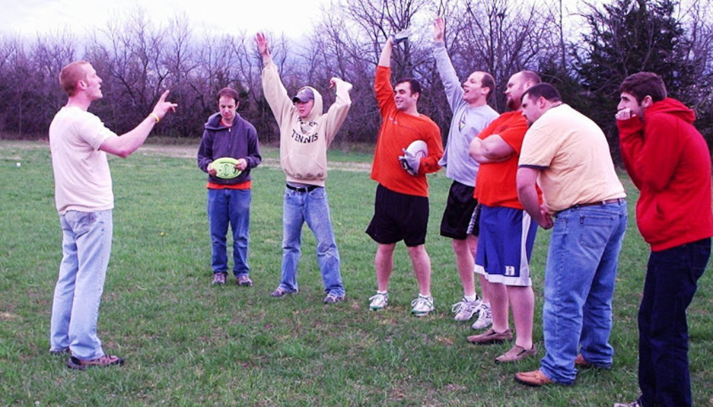

Slide 9
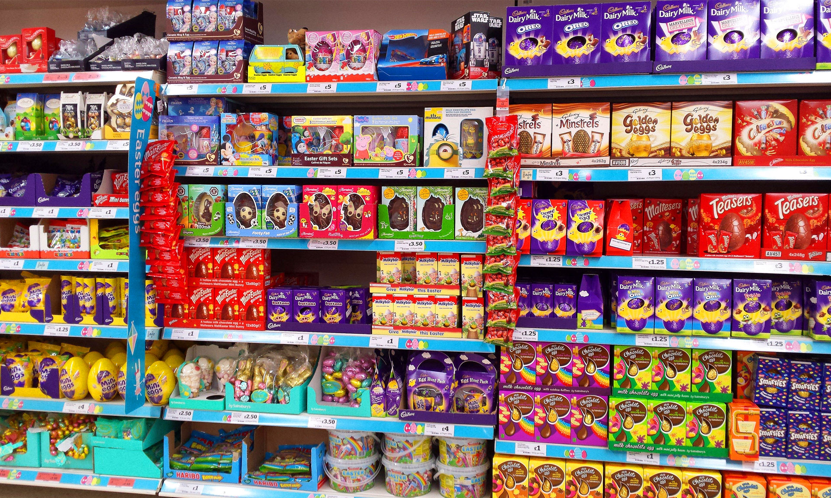
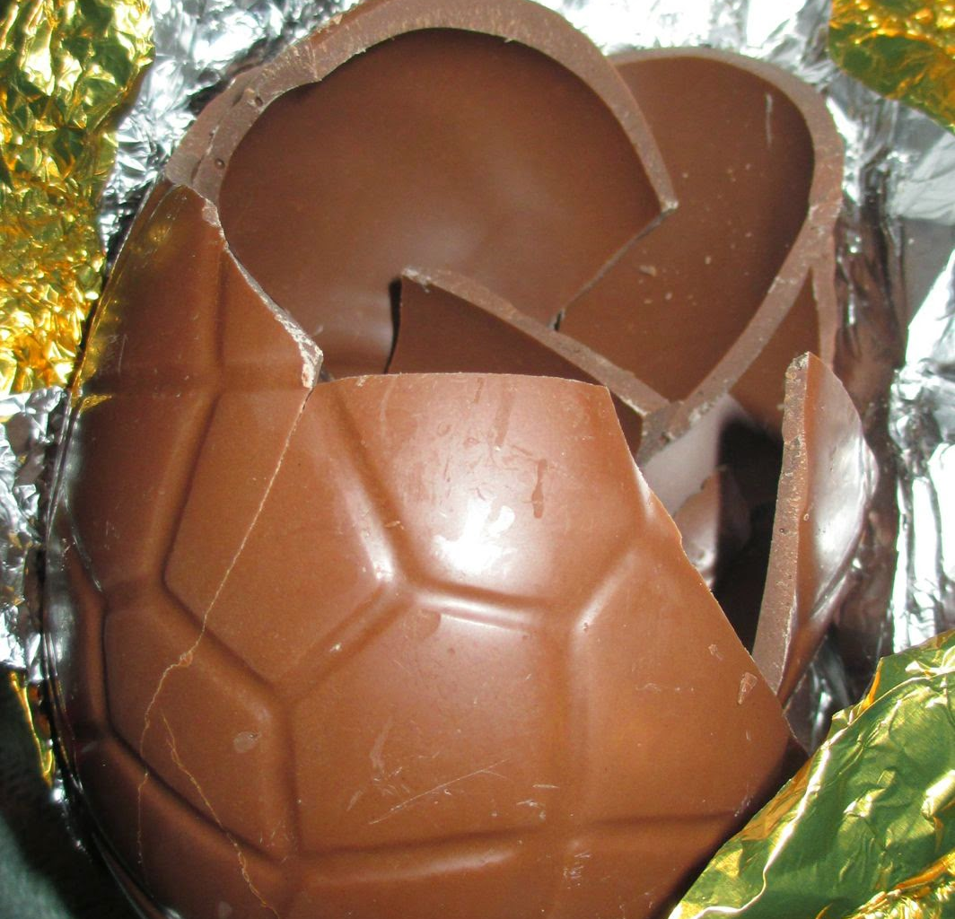

Slide 10
Truth is, the “I’m ready, I got this, hand me the reins” people scare me. I like the
“I’m not ready; if God doesn’t show up, this will be a disaster” kind of person.

Slide 11
Jesus and friends
The who and how:
The people sent – Jesus’ disciples – his friends
The power given – the Holy Spirit
The mission and the message:
Forgiveness
Faith

Slide 12
Jesus and friends
The who and how:
The people sent – Jesus’ disciples – his friends
The power given – the Holy Spirit
The mission and the message:
Forgiveness
Faith

