Slide 1
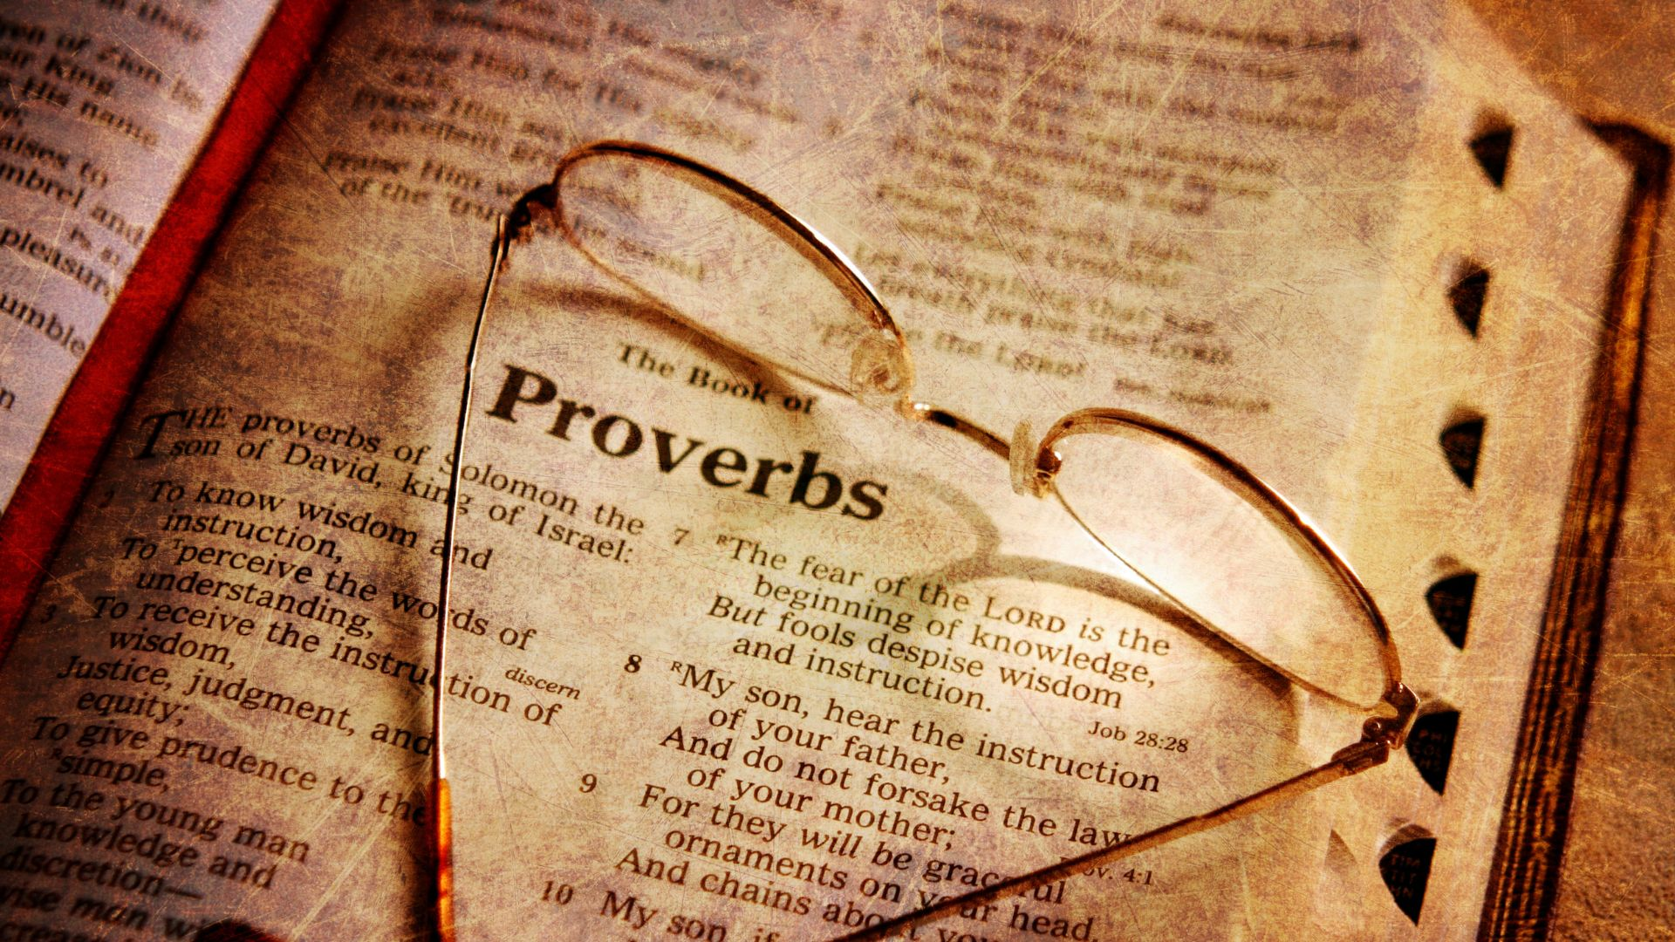
For the journey: Wisdom

Slide 2
Listen, my children, to a father’s instruction; pay attention
and gain understanding.
I give you sound learning, so do not forsake my teaching.
When I was a boy in my father’s house, still tender, and
an only child of my mother, he taught me and said,
“Lay hold of my words with all your heart; keep my
commands and you will live.
Get wisdom, get understanding; do not forget my words
or swerve from them.
(Proverbs 4 vs 1-5)

Slide 3
Do not forsake wisdom, and she will protect you; love her,
and she will watch over you.
Wisdom is supreme; therefore get wisdom. Though it cost
all you have, get understanding.
Esteem her, and she will exalt you; embrace her, and she
will honour you.
She will set a garland of grace on your head and present
you with a crown of splendor.”
Listen, my child, accept what I say, and the years of your
life will be many.
(Proverbs 4 vs 6-10)

Slide 4
I guide you in the way of wisdom and lead you along
straight paths.
When you walk, your steps will not be hampered; when
you run, you will not stumble.
Hold on to instruction, do not let it go; guard it well, for it
is your life.
Do not set foot on the path of the wicked or walk in the
way of evil people.
Avoid it, do not travel on it; turn from it and go on your
way.
(Proverbs 4 vs 11-15)

Slide 5
For they cannot sleep till they do evil; they are robbed of
slumber till they make someone fall.
They eat the bread of wickedness and drink the wine of
violence.
The path of the righteous is like the first gleam of dawn,
shining ever brighter till the full light of day.
But the way of the wicked is like deep darkness;
they do not know what makes them stumble.
My child, pay attention to what I say; listen closely to my words.
(Proverbs 4 vs 16-20)

Slide 6
Do not let them out of your sight, keep them within your
heart; for they are life to those who find them and health
to a person’s whole body.
Above all else, guard your heart, for it is the wellspring of
life.
Put away perversity from your mouth; keep corrupt talk
far from your lips.
Let your eyes look straight ahead, fix your gaze directly
before you.
(Proverbs 4 vs 21-25)

Slide 7
Make level paths for your feet and take only ways that are
firm.
Do not swerve to the right or the left; keep your foot from
evil.
(Proverbs 4 vs 26-27)

Slide 11
A foundation of relationship

Slide 12
A foundation of relationship
Litter-pickers, not plates

Slide 13
A foundation of relationship
Litter-pickers, not plates
Value wisdom

Slide 14
What does wisdom do?
Protects
Helps us avoid sin
Companion on life’s journey
A matter of the heart

Slide 15
Pursue wisdom by…
Reading the Bible
Asking God
Fixing your eyes on Jesus

