Slide 2
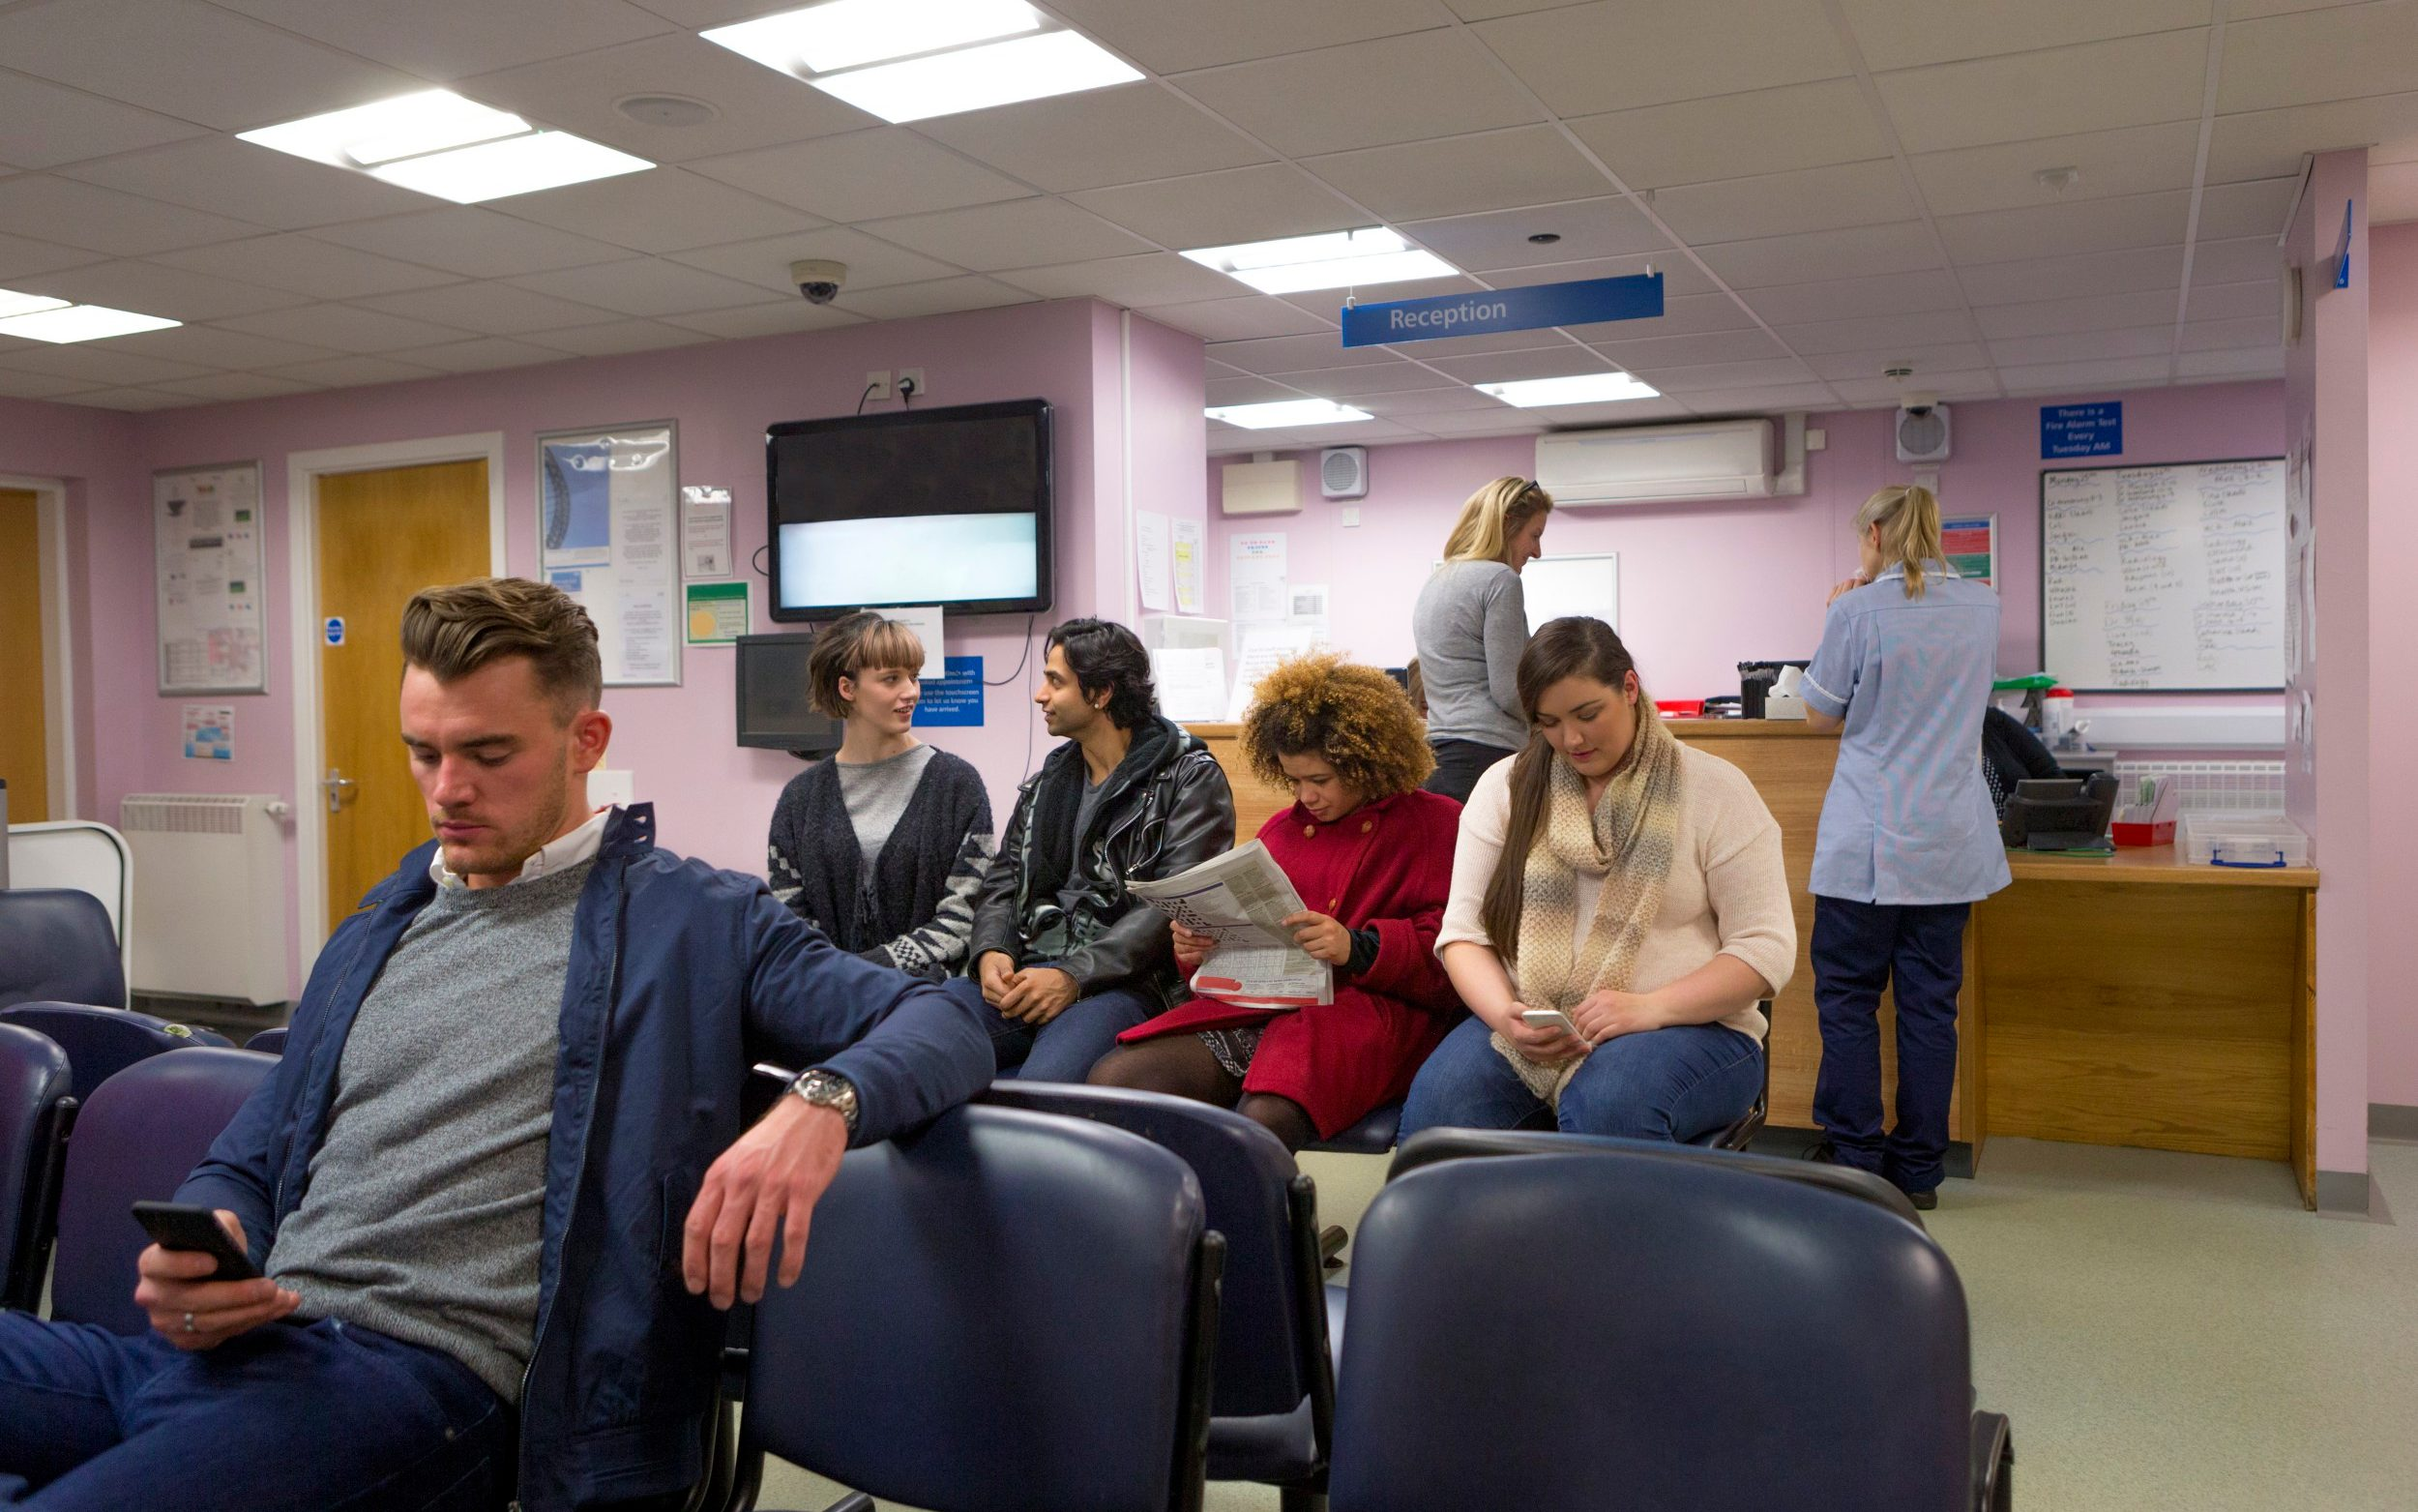
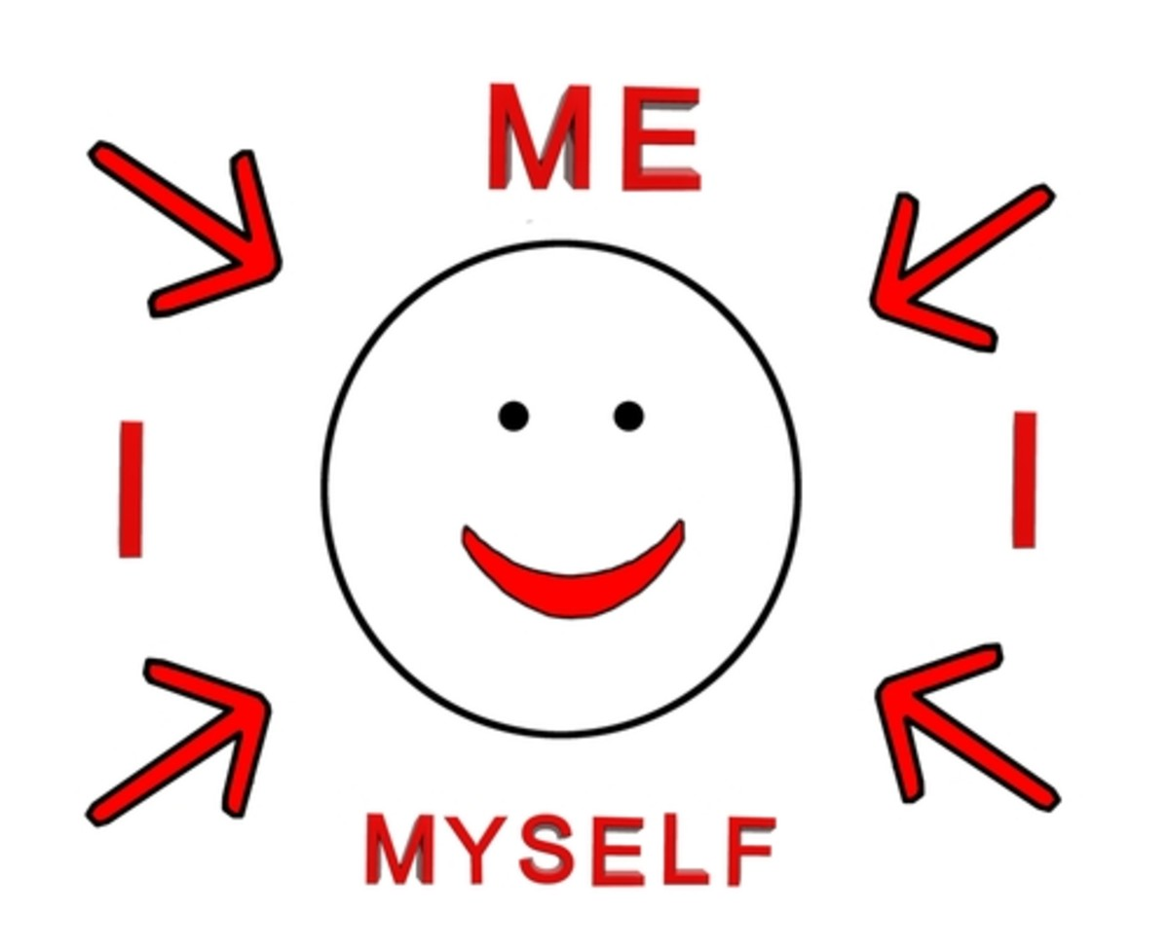

Slide 3
For Christians, a better way of understanding pilgrimage might be as being “a journey with God to know more of Him”.

Slide 4
…And what does the LORD require of you?
To act justly and to love mercy and
to walk humbly with your God.
(Micah ch 6 v 8)

Slide 5
“Six days do your work, but on the seventh day do not work, so that your ox and your donkey may rest and the slave born in your household, and the alien as well, may be refreshed.
“Be careful to do everything I have said to you. Do not invoke the names of other gods; do not let them be heard on your lips.
“Three times a year you are to celebrate a festival to me.
(Exodus ch 23 vs 12-14)

Slide 6
“Celebrate the Feast of Unleavened Bread; for seven days eat bread made without yeast, as I commanded you. Do this at the appointed time in the month of Abib, for in that month you came out of Egypt.
“No one is to appear before me empty-handed.
“Celebrate the Feast of Harvest with the firstfruits of the crops you sow in your field.
“Celebrate the Feast of Ingathering at the end of the year, when you gather in your crops from the field.
(Exodus ch 23 vs 15-16)

Slide 7
“Three times a year all the men are to appear before the Sovereign LORD.
“Do not offer the blood of a sacrifice to me along with anything containing yeast.
“The fat of my festival offerings must not be kept until morning.
“Bring the best of the firstfruits of your soil to the house of the LORD your God.
“Do not cook a young goat in its mother’s milk.”
(Exodus ch 23 vs 17-19)

Slide 8
the weekly requirement of rest – Six days do your work, but on the seventh day do not work.
the termly ask of festivals – Three times a year you are to celebrate a festival to me.
the annual opportunity for feasts – Celebrate the Feast of Ingathering at the end of the year.

Slide 9
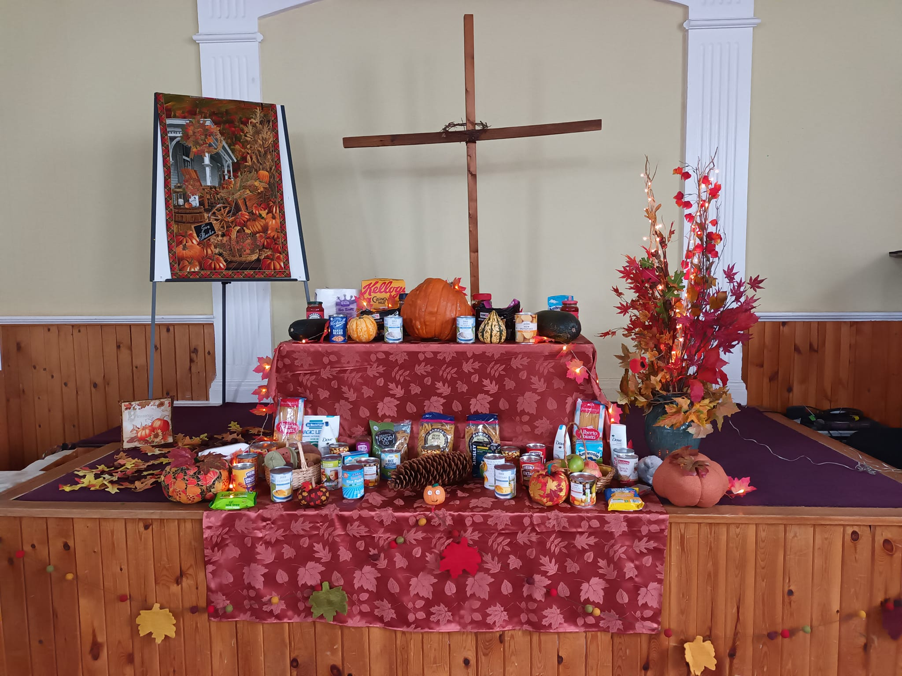

Slide 10
Good habits are actually quite freeing – they mean we accomplish good things almost on autopilot. One study from Duke University found that more than 40% of the actions people take every day aren’t conscious decisions, but habits.
(Sim Dendy)

Slide 11
Take your Sabbath rest
Weekly gathering
Regular ‘Communion’
Small Groups
Occasional retreats
Mentoring
Christmas & Easter

